Slide 1
Student Tuition Forum Financial Briefing
January 14, 2025

Slide 2
Agenda
UO Budget
State Appropriation
Cost Drivers
Guaranteed Tuition Program
Info and Input on Tuition
Small Group Discussion

Slide 3
UO Budget Structure
E&G Funds
Other Funds
Tuition revenue
State Appropriation
F&A Return
Overhead revenue
Fee revenue, interest earnings
Grants and Contracts revenue
Auxiliary Revenue
Service Center Revenue
Designated Operations Revenue
Restricted gifts
School & College Budgets
Grants & Contracts
Central Admin
Budgets
Plant Funds
Institutional Expenses
(Debt, assessments, utilities, leases)
Auxiliary, Service Centers, and Designated Ops Funds
Restricted Gifts

Slide 4
E&G Fund Balance
 | FY2018 | FY2019 | FY2020 | FY2021 | FY2022 | FY2023 | FY2024
Total Expenses including CapEx | $520.0M | $544.0M | $552.6M | $524.1M | 564.5M | $597.6M | $650.0M
Weekly OpEx | $10.0M | 10.5M | $10.6M | $10.1M | $10.9M | $11.5M | $12.5M
End of Year Fund Balance | $80.0M | $65.4M | $56.7M | $65.3M | $93.3M | $114.3M | $118.4M
Weeks of OpEx | 8.0 | 6.3 | 5.3 | 6.5 | 8.6 | 9.9 | 9.5

Slide 5
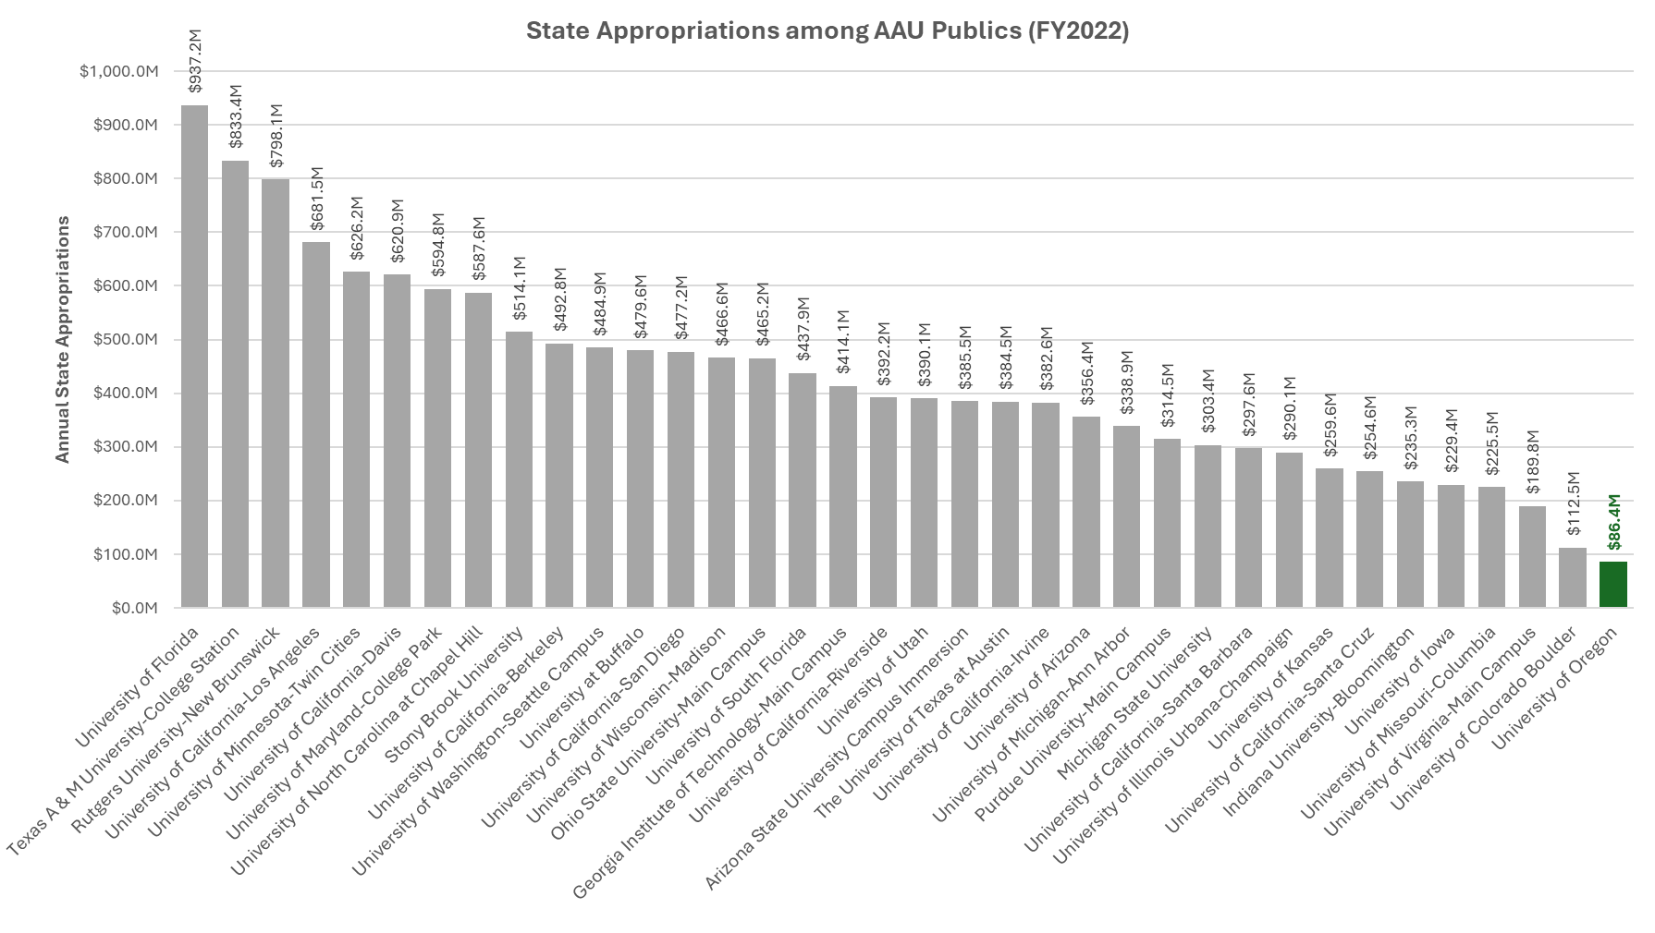
Annual State Appropriations to
Public AAU Institutions, FY2022

Slide 6
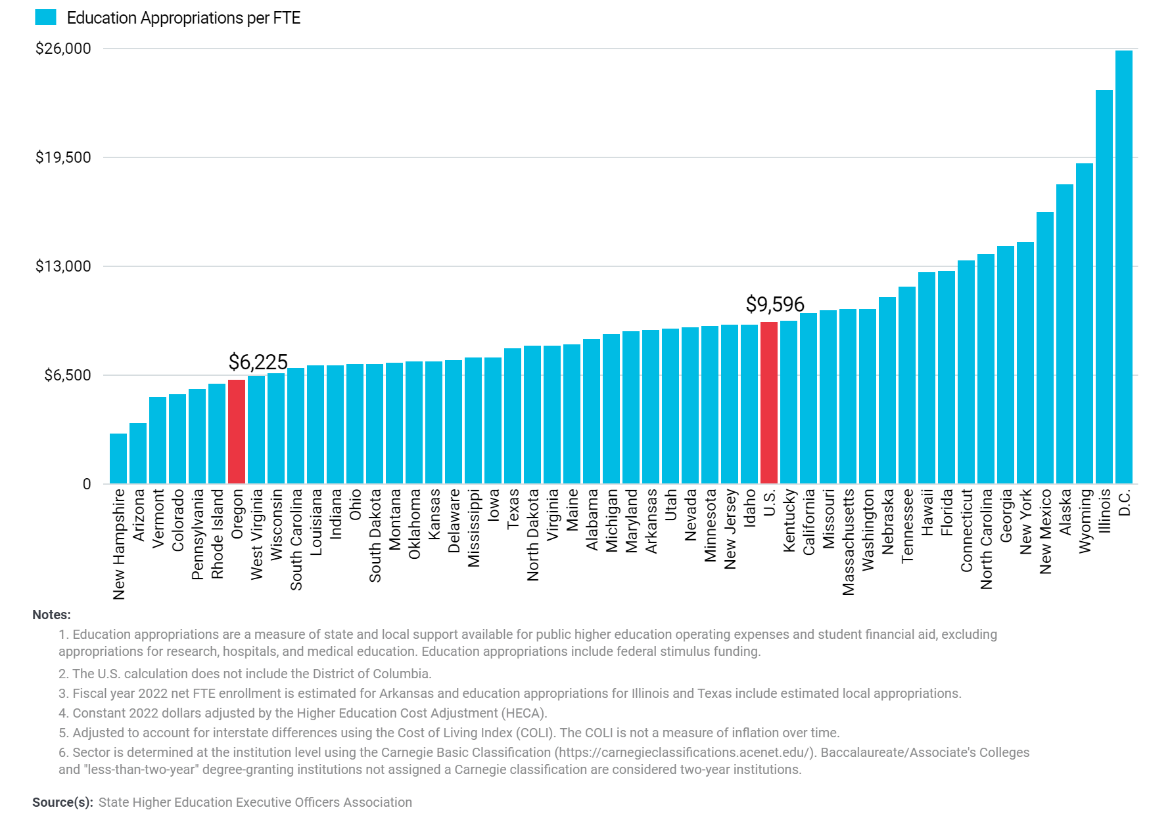
Public Higher Education Appropriations per FTE by State at
Four-Year Institutions, FY2022 (Adjusted)

Slide 7
Comparative University Funding
FY 2024 | EOU | OIT | OSU | PSU | SOU | UO | WOU | Total
Fundable Students | 1,532 | 2,531 | 17,936 | 12,276 | 2,395 | 12,794 | 3,061 | 52,526
PUSF Funding | $23.2M | $34.3M | $159.2M | $119.8M | $27.5M | $92.4M | $33.1M | $489.5M
PUSF Funding Per Fundable Student | $15,161 | $13,532 | $8,874 | $9,760 | $11,482 | $7,224 | $10,803 | $9,318
Total FY 2024 State Funding | $25.7M | $38.1M | $301.3M | $131.1M | $30.0M | $97.0M | $35.8M | $659.1M
State Funding per Fundable Student | $16,760 | $15,056 | $16,798 | $10,683 | $12,532 | $7,584 | $11,699 | $12,548

Slide 8
Comparative University Funding
FY 2024 | EOU | OIT | OSU | PSU | SOU | UO | WOU | Total
Net Tuition Revenue | $23.9M | $31.4M | $469.7M | $175.2M | $33.9M | $504.3M | $31.5M | $1,269.9M
State & Governmental Appropriations | $25.4M | $36.8M | $302.7M | $131.6M | $27.9M | $98.2M | $34.8M | $657.4M
Other Revenue | $2.9M | $3.8M | $142.4M | $40.1M | $3.6M | $52.6M | $4.8M | $250.3M
Total E&G Revenue | $52.3M | $72.0M | $914.8M | $347.0M | $65.4M | $655.1M | $71.0M | $2,177.5M
Percentage of E&G Funded with State & Governmental Appropriations | 48.7% | 51.2% | 33.1% | 37.9% | 42.6% | 15.0% | 48.9% | 30.2%
Sources:
Various university FYE Actual BOT Management Reports. WOU Q3 Forecast.

Slide 9
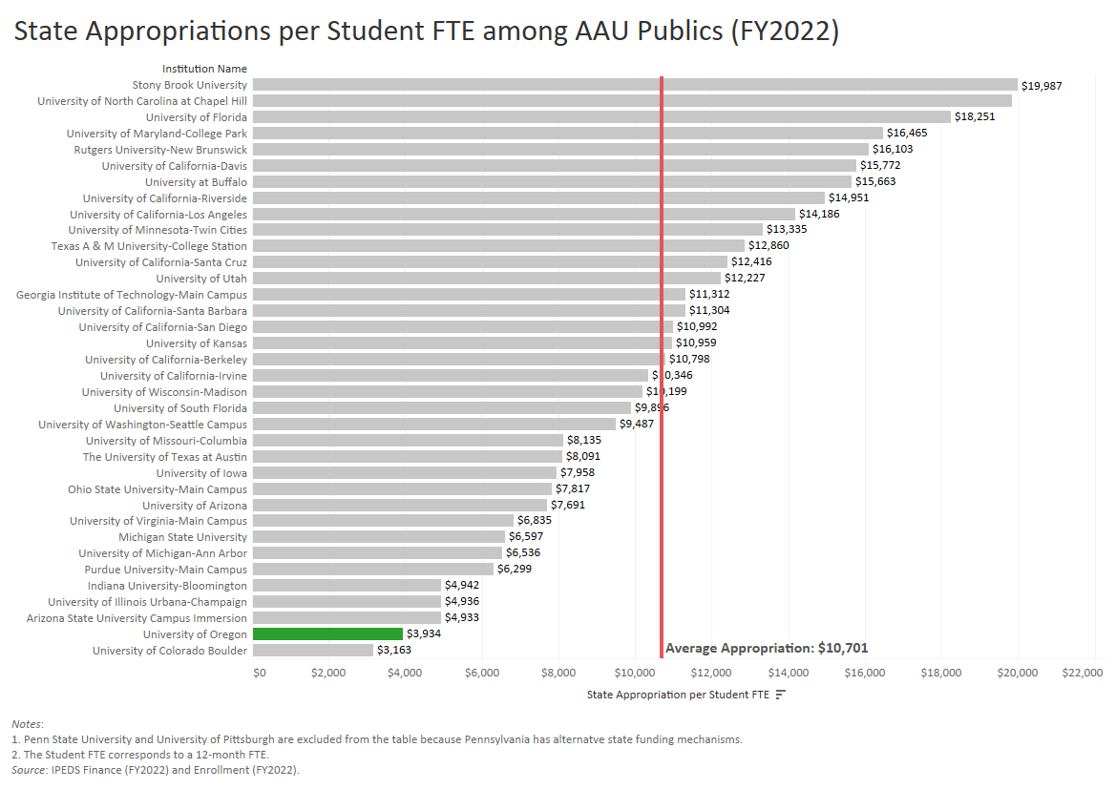

Slide 10
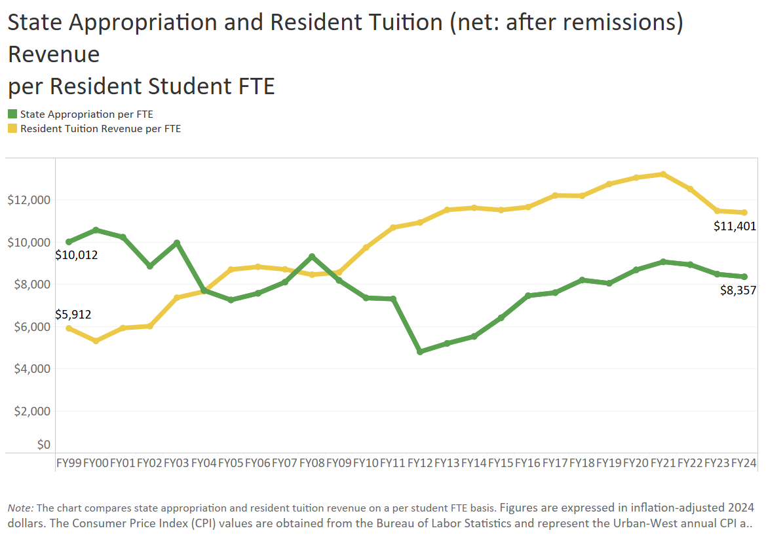

Slide 11
Agenda
UO Budget
State Appropriation
Cost Drivers
Guaranteed Tuition Program
Info and Input on Tuition
Small Group Discussion

Slide 12
Summary – Major FY2026 E&G Fund Cost Drivers
Cost Driver | Projected FY26 Cost Increase | Notes
Faculty, Staff and GE Salary and OPE | $19.5 million | E&G compensation increases based on current contracts (e.g., classified staff, GE), announced increases for OAs and historical rates / current administrative proposals for those groups without ratified contracts. Includes approximately 1,200 graduate employees, 1,630 faculty, 850 classified staff and 1,220 unrepresented staff on the E&G fund. Does not include any projected expenses related to adding staff.
Medical Costs | $2.9 million | Includes increases of 4.15% on December 1, 2024, and 4.6% on December 1, 2025.
Retirement Costs | $7.6 million | Increases for PERS rates for FY26 as approved by PERS board.
Blended OPE | ($7.2 million) | Blended OPE carryforward (atypical leave and hiring dynamics) balances from a previous period are buying down benefits expenses during FY26 on a one-time basis.
Institutional Expenses | $2.6 million | Increases related to utilities, insurance, debt for academic buildings, assessments, and leases.
Faculty Hiring | $1.6 million | 8 Net Tenure Track Hires.
Strategic Investments | $1.0 million | Allocated via strategic investment process. Note that President has only allocated $1.0 million to the BAG process this year as funds are needed for strategic priorities.
Total Projected Cost Increases | $28.0 million

Slide 13
Summary – Major FY2026 E&G Fund Cost Drivers
Cost Driver | FY25 Base | Projected FY26 Cost Increase | FY26 Increase (%)
Faculty, Staff and GE Compensation | $546.0 million | $19.5 million | 3.6%
Medical Costs | $63.3 million | $2.9 million | 4.6%
Retirement Costs | $80.9 million | $7.6 million | 9.4%
Blended OPE | $179.5 million | ($7.2 million) | (4.0%)
Institutional Expenses | $49.0 million | $2.6 million | 5.3%
TTF Faculty Hiring | $145.1 million | $1.6 million | 1.1%
Strategic Investments | $690.5 million | $1.0 million | 0.1%
Total (E&G Budget) | $690.5 million | $28.0 million | 4.1%

Slide 14
Summary – Major FY2026 E&G Fund Cost Drivers
Cost Driver | Projected FY20 Cost Increase | Projected FY21 Cost Increase | Projected FY22 Cost Increase | Projected FY23 Cost Increase | Projected FY24 Cost Increase | Projected FY25 Cost Increase | Projected FY26 Cost Increase
Faculty, Staff & GE Salary & Wages | $10.6 million | $11.6 million | $7.3 million | $15.0 million | $11.9 million | $13.0 million | $19.5 million
Medical Costs | $1.9 million | $2.5 million | $1.2 million | $1.6 million | $2.2 million | $2.5 million | $2.9 million
Retirement Costs | $7.1 million | ($500K) | - | - | $1.9 million | - | $7.6 million
Oregon Paid Leave | - | - | - | - | $900K | $300K | -
Blended OPE | - | - | - | - | $4.0 million | - | ($7.2 million)
Institutional Expenses | $1.0 million | $1.5 million | $1.2 million | $1.2 million | $1.5 million | $2.0 million | $2.6 million
Faculty Hiring | - | - | - | - | - | $3.0 million | $1.6 million
Strategic Investments | $2.0 million | $2.0 million | $600K | $2.0 million | $2.0 million | $2.0 million | $1.0 million
Minimum Wage Increase | $1.0 million | $1.9 million | $320K | $257K | - | - | -
Total Projected Cost Increases | $23.6 million | $19.0 million | $10.6 million | $20.1 million | $24.4 million | $22.8 million | $28.0 million

Slide 15
Agenda
UO Budget
State Appropriation
Cost Drivers
Guaranteed Tuition Program
Info and Input on Tuition
Small Group Discussion

Slide 16
Framework – Guaranteed Tuition Program
for Undergraduate Students
For each entering class year, there is a set resident and non-resident tuition rate per student credit hour (SCH)
That rate is guaranteed or locked for five years - no matter what
Other tuition and fees that are locked include administratively controlled mandatory fees, summer tuition, honors college differential tuition, business school differential tuition and the international student fee
Students know the expected cost of their education before they decide to come to the University of Oregon

Slide 17
Average Historical Annual Undergraduate Tuition Rate Increases – Analysis conducted in FY2020
10 Year Average
5 Year Average
Resident
5.4%
5.0%
Non-resident
4.4%
3.3%

Slide 18
New Resident Undergraduate Students Graduation Time 4 years Analysis Conducted in FY2020 Assumed Annual Increases 5% - Average 5 Year Historical Rate 5 year Guaranteed rate $254.62 per SCH (9.75% increase)
Total Tuition
Paid
$1,050
Total Tuition
Paid
$1,018

Slide 19
New Resident Undergraduate Students Graduation Time 5 years Analysis Conducted in FY2020 Assumed Annual Increases 5% - Average 5 Year Historical Rate 5 year Guaranteed rate $254.62 per SCH (9.75% increase)
Total Tuition
Paid
$1,346
Total Tuition
Paid
$1,273

Slide 20
New Resident Undergraduate Students Graduation Time 8 years Analysis Conducted in FY2020 Assumed Annual Increases 5% - Average 5 Year Historical Rate 5 year Guaranteed rate $254.62 per SCH (9.75% increase)
Total Tuition
Paid
$2,326
Total Tuition
Paid
$2,116

Slide 21
Advantages of Guaranteed Tuition Program for Students
Financial Predictability: Tuition rates are locked in for five years – students and their families know ahead of time exactly what they are going to pay for their education.
Peace of Mind: The guaranteed tuition program functions as a insurance policy for students. Regardless of what happens to state funding or other costs, their tuition rates are guaranteed for five years.
Protection of Scholarship Value: Many scholarships are currently fixed dollar amounts. Under a guaranteed tuition program, the value of these scholarships remains the same over their college career.

Slide 22
Advantages of Guaranteed Tuition Program for Institution
Recruiting: The stronger value proposition of a locked-in rate should be very attractive to new students. This should help support the institution’s enrollment growth initiative.
Retention: One of the main reasons students cite for dropping out of school is financial pressure. This can often be linked to students not anticipating tuition increases throughout their college career. Having a locked rate for tuition should help with this issue.
Campus Climate: Concern about continually rising tuition rates affects students, faculty and staff, and directs time, energy and focus away from other important educational issues.

Slide 23
Opportunities for Learning and Input
UO tuition website: https://tuition.uoregon.edu
Input to TFAB during meetings (all open to the public): https://tuition.uoregon.edu/tfab-schedule
Input to ASUO
President’s forum in February to receive input on tuition recommendations
Community survey input to the President following release of TFAB recommendations in February
Get involved: https://www.uoadvocates.com/

Slide 24
Agenda
UO Budget
State Appropriation
Cost Drivers
Guaranteed Tuition Program
Info and Input on Tuition
Small Group Discussion

