Slide 1
Guaranteed Tuition Program
November 8, 2022
Tuition and Fee Advisory Board

Slide 2
Framework – Guaranteed Tuition Program
for Undergraduate Students
For each entering class year, there is a set resident and non-resident tuition rate per student credit hour (SCH)
That rate is guaranteed or locked for five years - no matter what
Other tuition and fees that are locked include administratively controlled mandatory fees, summer tuition, honors college differential tuition, business school differential tuition and the international student fee
Students know the expected cost of their education before they decide to come to the University of Oregon

Slide 3
Average Historical Annual Undergraduate Tuition Rate Increases – Analysis conducted in FY2020
10 Year Average
5 Year Average
Resident
5.4%
5.0%
Non-resident
4.4%
3.3%

Slide 4
New Resident Undergraduate Students Graduation Time 4 yrs Analysis Conducted in FY2020 Assumed Annual Increases 5% - Average 5 Year Historical Rate 5 year Guaranteed rate $254.62 per SCH (9.75% increase)
Total Tuition
Paid
$1,050
Total Tuition
Paid
$1,018

Slide 5
New Resident Undergraduate Students Graduation Time 5 yrs Analysis Conducted in FY2020 Assumed Annual Increases 5% - Average 5 Year Historical Rate 5 year Guaranteed rate $254.62 per SCH (9.75% increase)
Total Tuition
Paid
$1,346
Total Tuition
Paid
$1,273

Slide 6
New Resident Undergraduate Students Graduation Time 8 yrs Analysis Conducted in FY2020 Assumed Annual Increases 5% - Average 5 Year Historical Rate 5 year Guaranteed rate $254.62 per SCH (9.75% increase)
Total Tuition
Paid
$2,326
Total Tuition
Paid
$2,116

Slide 7
Advantages of Guaranteed Tuition Program for Students
Financial Predictability: Tuition rates are locked in for five years – students and their families know ahead of time exactly what they are going to pay for their education.
Peace of Mind: The guaranteed tuition program functions as a insurance policy for students. Regardless of what happens to state funding or other costs, their tuition rates are guaranteed for five years.
Protection of Scholarship Value: Many scholarships are currently fixed dollar amounts. Under a guaranteed tuition program, the value of these scholarships remains the same over their college career.

Slide 8
Advantages of Guaranteed Tuition Program for Institution
Recruiting: The stronger value proposition of a locked-in rate should be very attractive to new students. This should help support the institution’s enrollment growth initiative.
Retention: One of the main reasons students cite for dropping out of school is financial pressure. This can often be linked to students not anticipating tuition increases throughout their college career. Having a locked rate for tuition should help with this issue.
Campus Climate: Concern about continually rising tuition rates affects students, faculty and staff, and directs time, energy and focus away from other important educational issues.

Slide 9
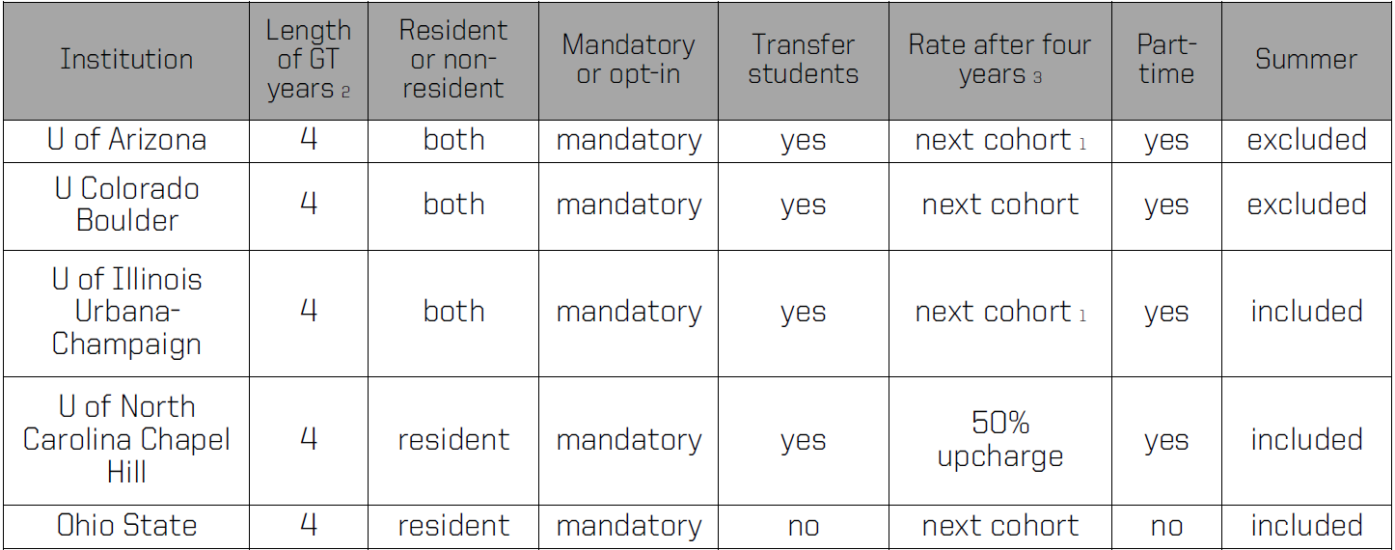
Guaranteed Tuition at Other Universities

Slide 10
Students who started prior to the Tuition Guarantee Program
Annual tuition increases for undergraduate students who started prior to the Guaranteed Tuition Program will be locked at 3.0% per year through FY2024
ANNUAL TUITION INCREASES FOR CURRENT STUDENTS LOCKED AT 3.0% PER YEAR
 | FY2021 SCH Rate | FY2022 SCH Rate | FY2023 SCH Rate | FY2024 SCH Rate
Resident Undergraduates | $238.96 | $246.13 | $253.51 | $261.12
Non-resident Undergraduates | $785.89 | $809.47 | $833.75 | $858.76

Slide 11
Guaranteed Tuition Program – Reserve Fund
New guaranteed program locks tuition and fee rates for new students for five years
Institution takes on more risk related to crisis situation (e.g., significant drop in state funding)
Tuition increases that would have been applied to all students can only be applied to new cohorts of students
Takes longer to adjust budget
Strategy: Establish new reserve fund ($20 million)
$4 million of institutional resources
$6 million of philanthropy
$10 million donor pledge re: crisis situation

