Slide 1


University of Oregon
Financial Briefing
Tuition and Fee Advisory Board
October 14, 2024
Brian Fox, Associate Vice President for
Budget, Financial Analysis and Data Analytics
JP Monroe, Director Institutional Research

Slide 2
Agenda
Historical & Comparative Data
UO Budget Structure
Key Sources of University Funding
Cost Drivers
E&G Fund Challenges
FY24 and Beyond

Slide 3
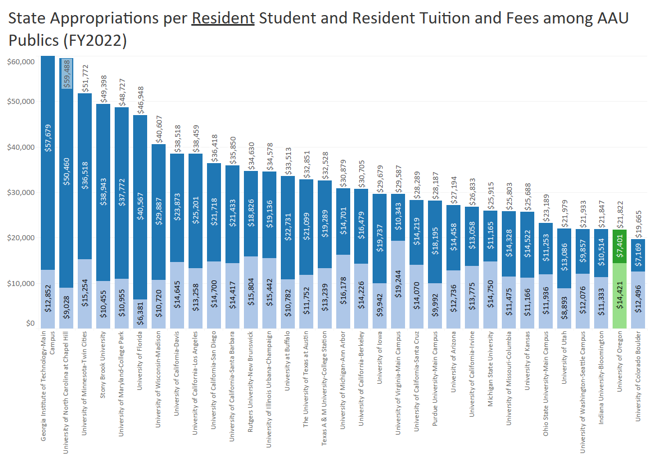

Slide 4
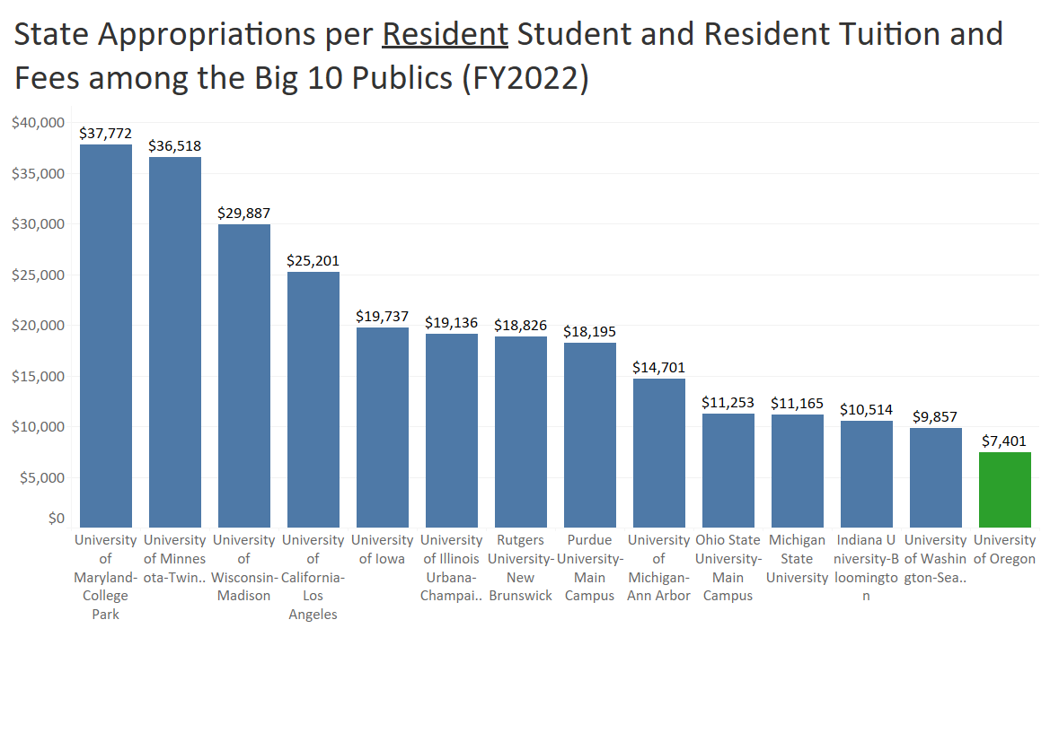

Slide 5
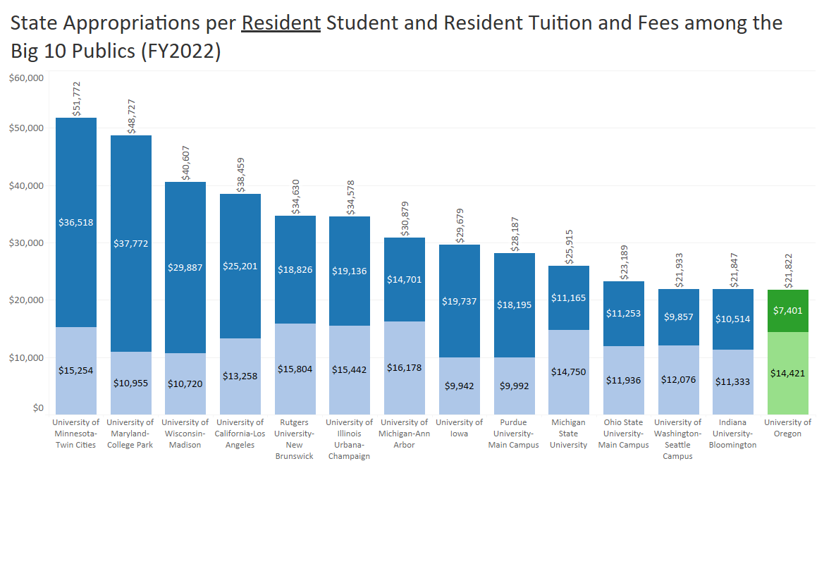

Slide 6
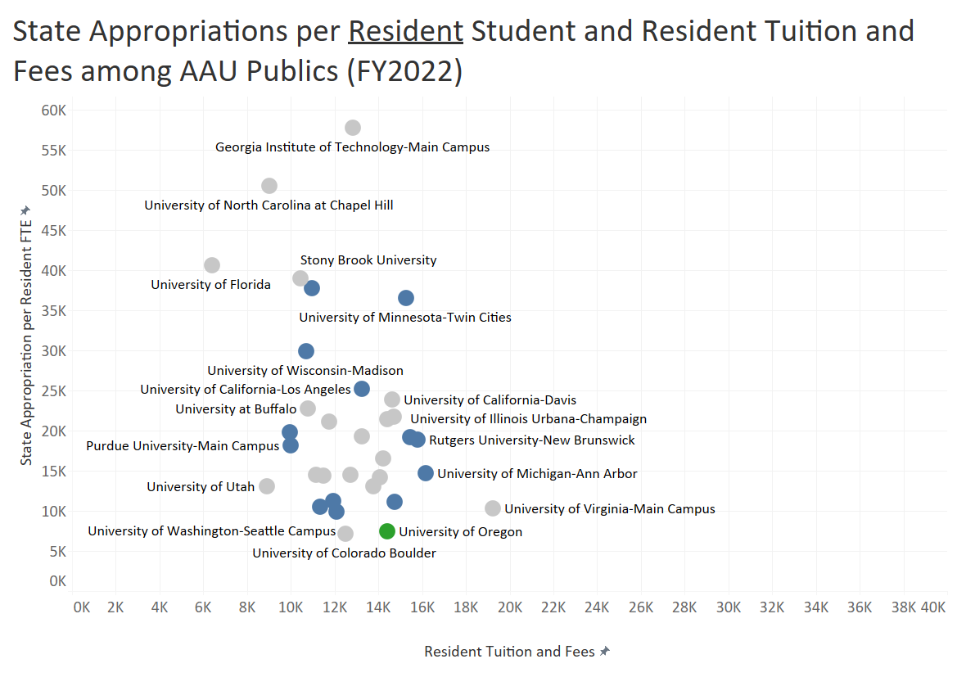

Slide 7
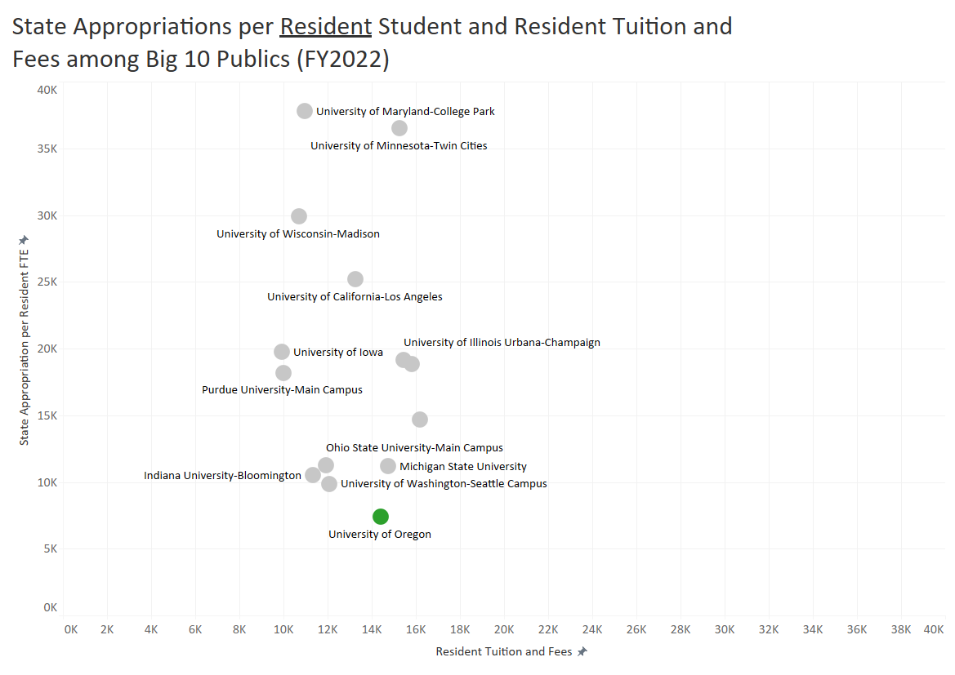

Slide 8
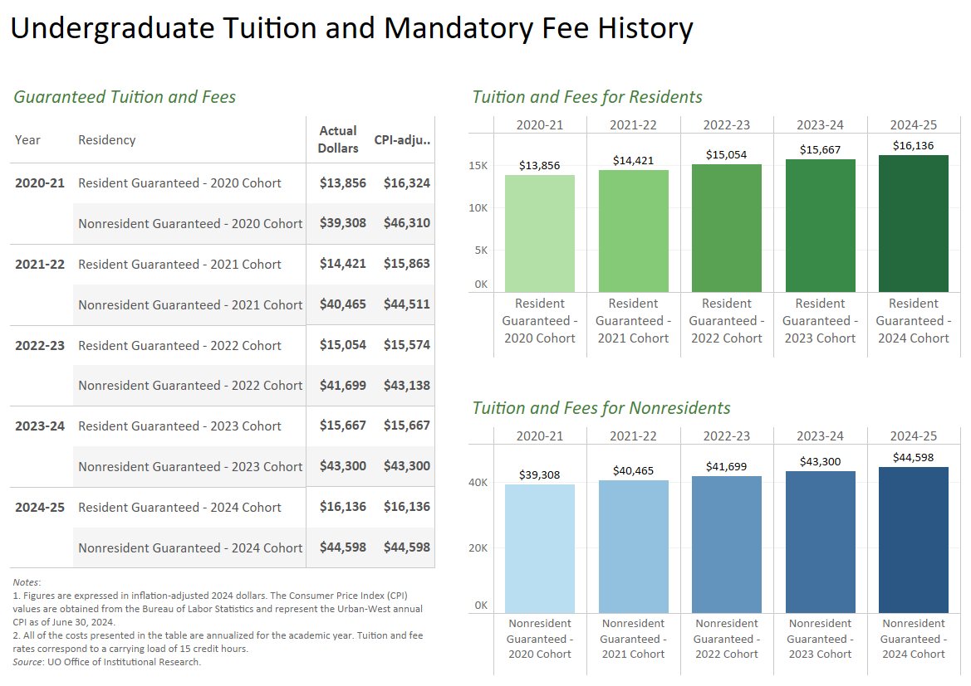

Slide 9
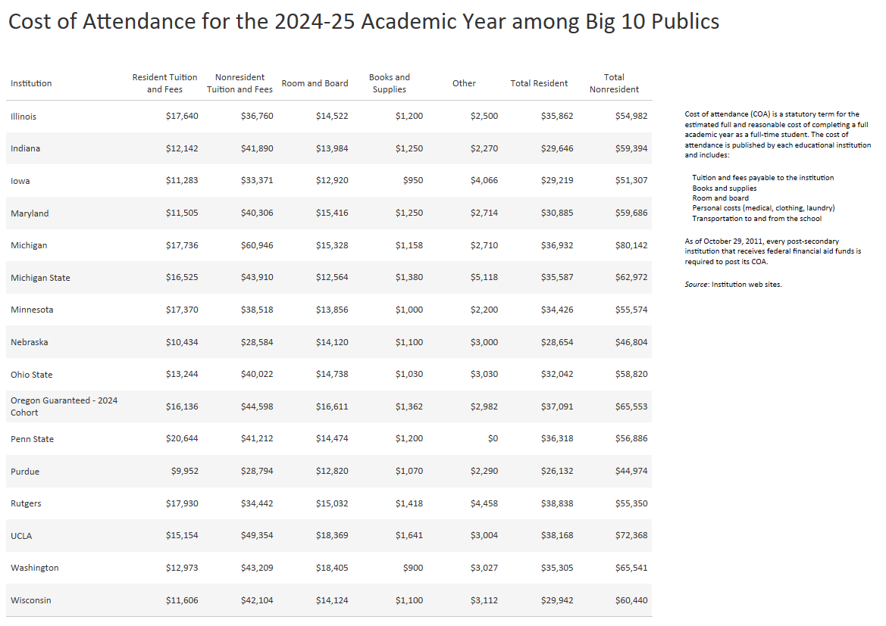

Slide 10
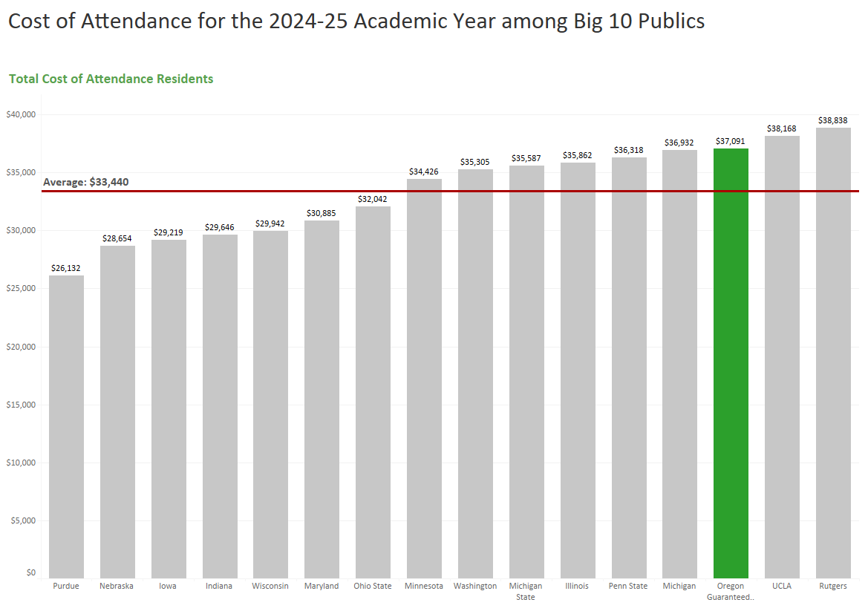

Slide 11
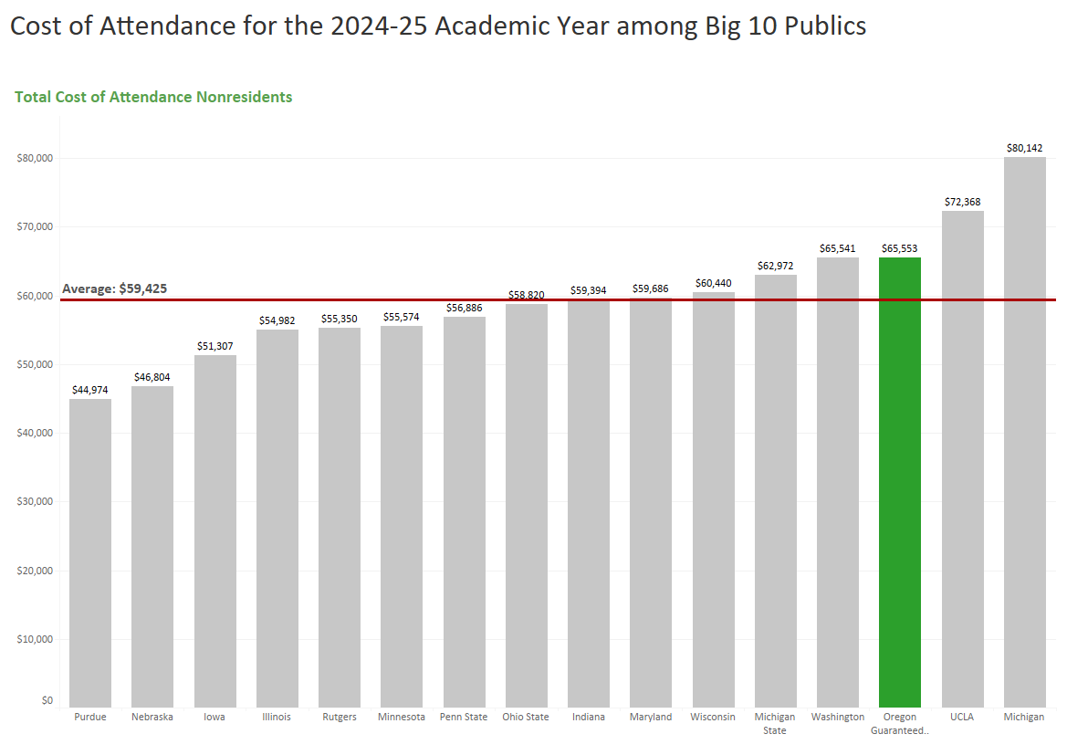

Slide 12
Agenda
Historical & Comparative Data
UO Budget Structure
Key Sources of University Funding
Cost Drivers
E&G Fund Challenges
FY24 and Beyond

Slide 13
UO Budget Structure
E&G Funds
Other Funds
Tuition revenue
State Appropriation
F&A Return
Overhead revenue
Fee revenue, interest earnings
Grants and Contracts revenue
Auxiliary Revenue
Service Center Revenue
Designated Operations Revenue
Restricted gifts
School & College Budgets
Grants & Contracts
Central Admin
Budgets
Plant Funds
Institutional Expenses
(Debt, assessments, utilities, leases)
Auxiliary, Service Centers, and Designated Ops Funds
Restricted Gifts

Slide 14
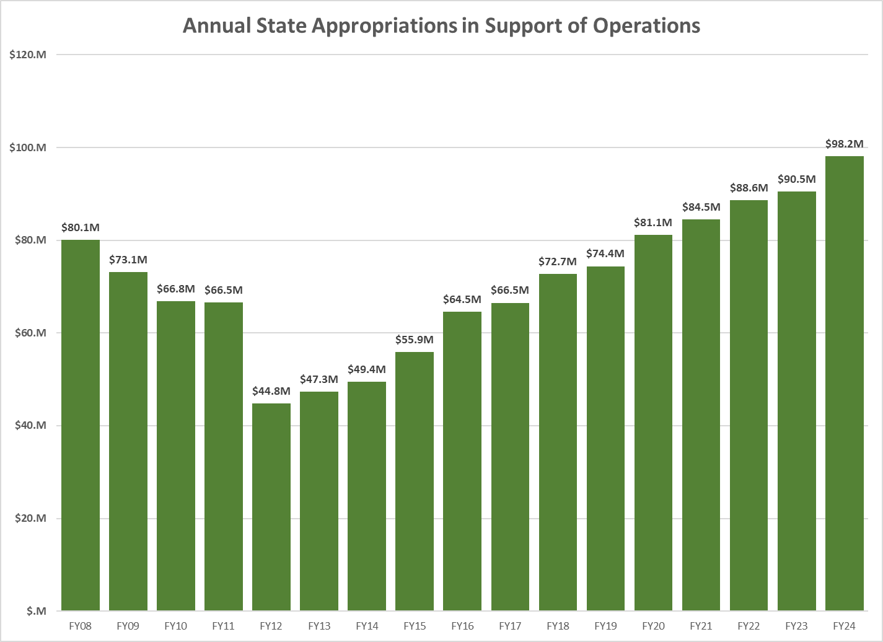
Notes:
Updated with Brian info

Slide 15
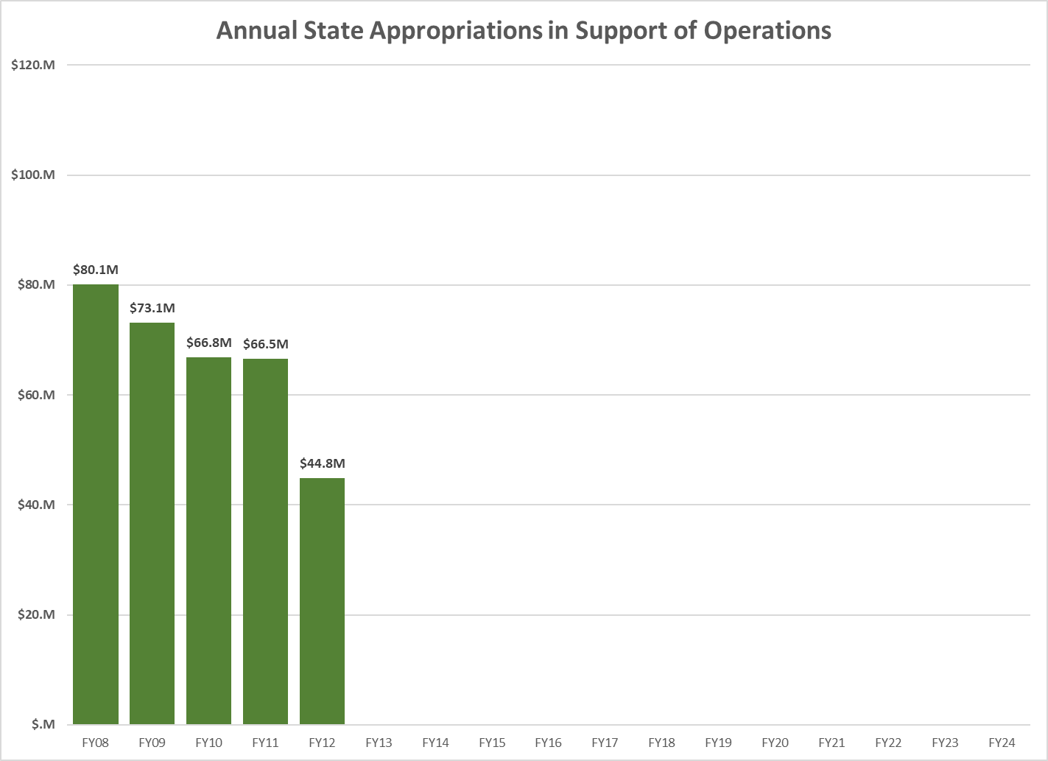
Notes:
Updated with Brian info

Slide 16
Notes:
Updated with Brian info

Slide 17
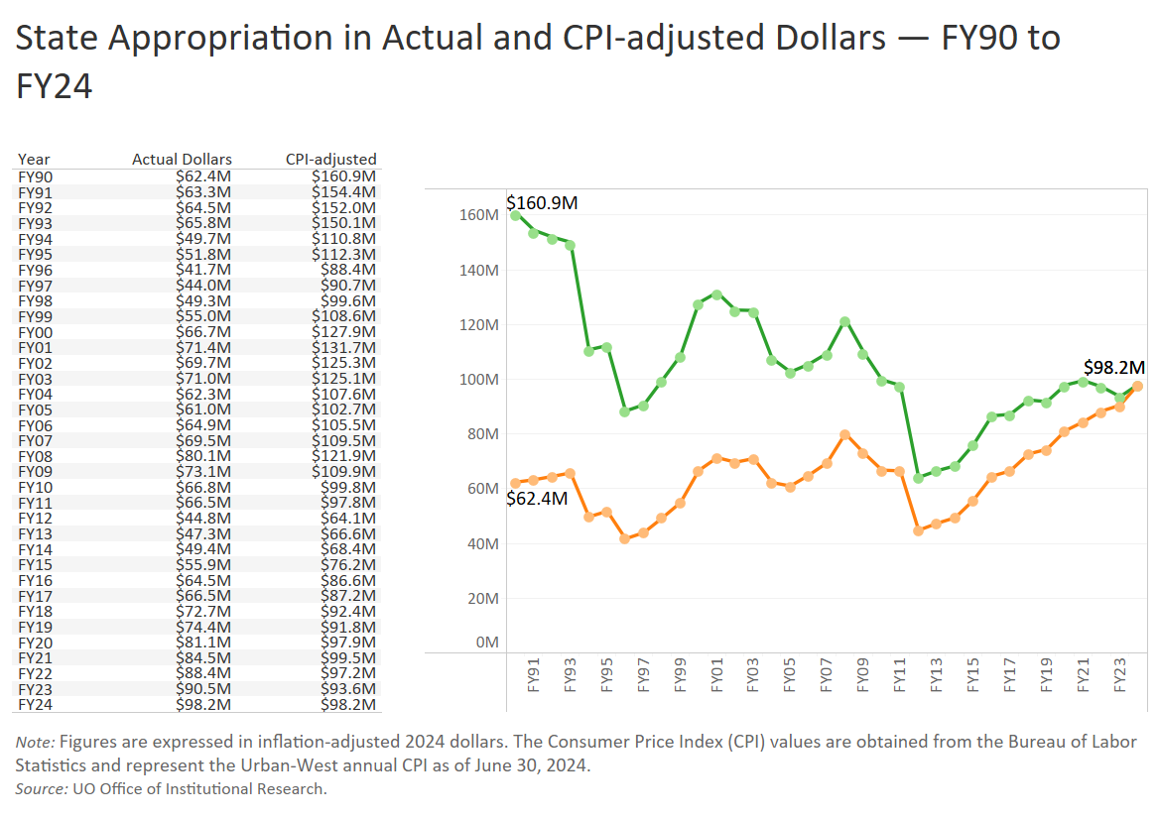

Slide 18
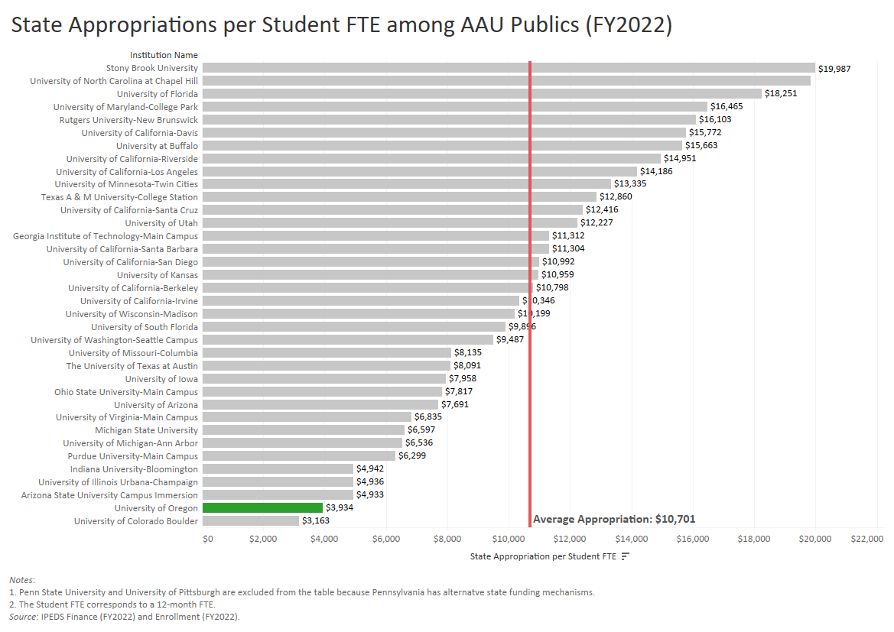

Slide 20
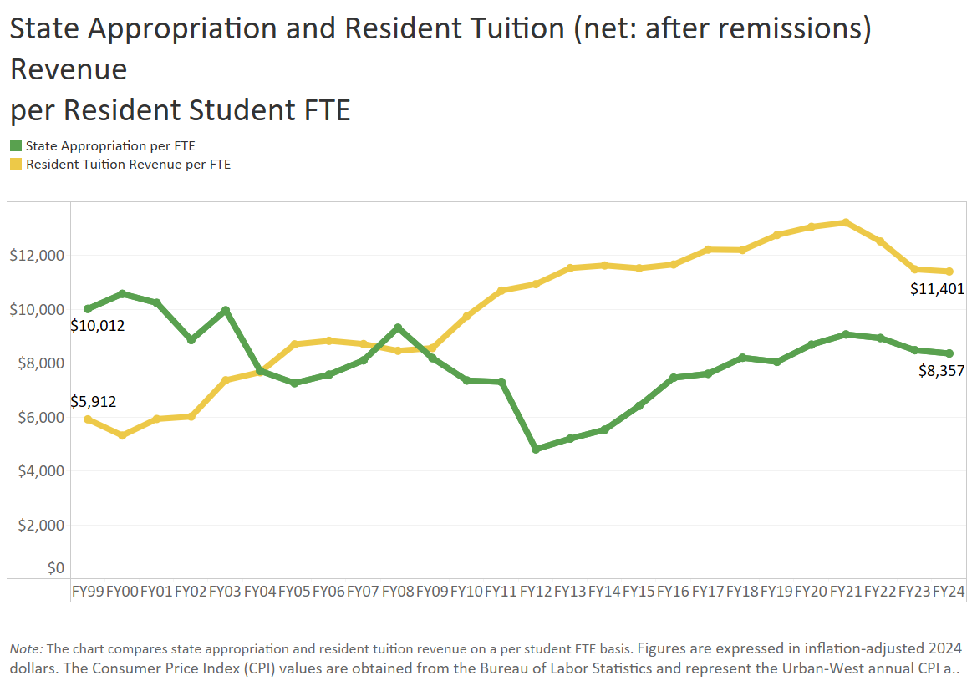

Slide 21
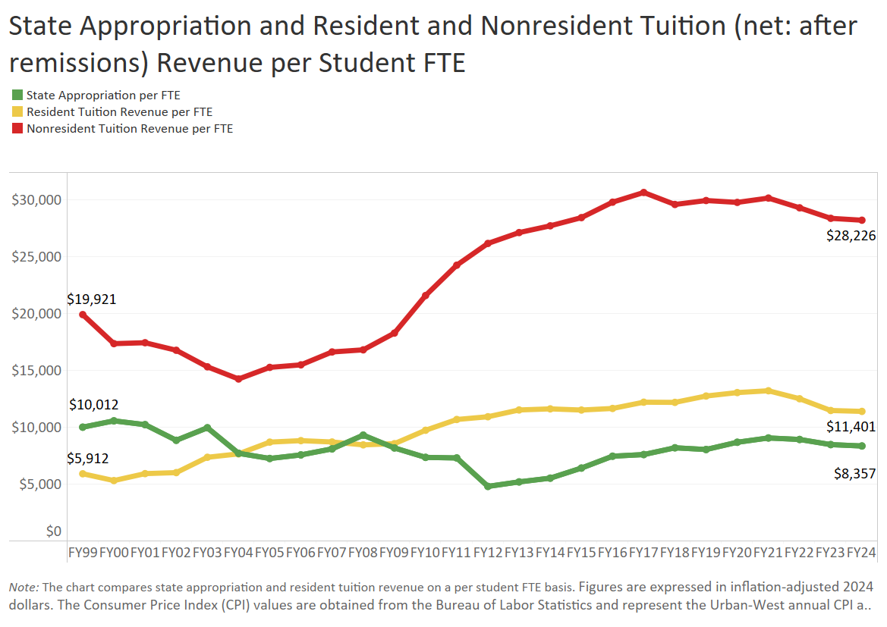

Slide 22
University Resources
FY2024 Major Revenue Streams
(E&G Fund – Net of Remissions)
State Appropriation $98.2 million
Resident Tuition $114.5 mill
Resident Net Tuition $133.9 million
Nonresident Net Tuition $338.0 million
Notes:
Updated with Brian info

Slide 23
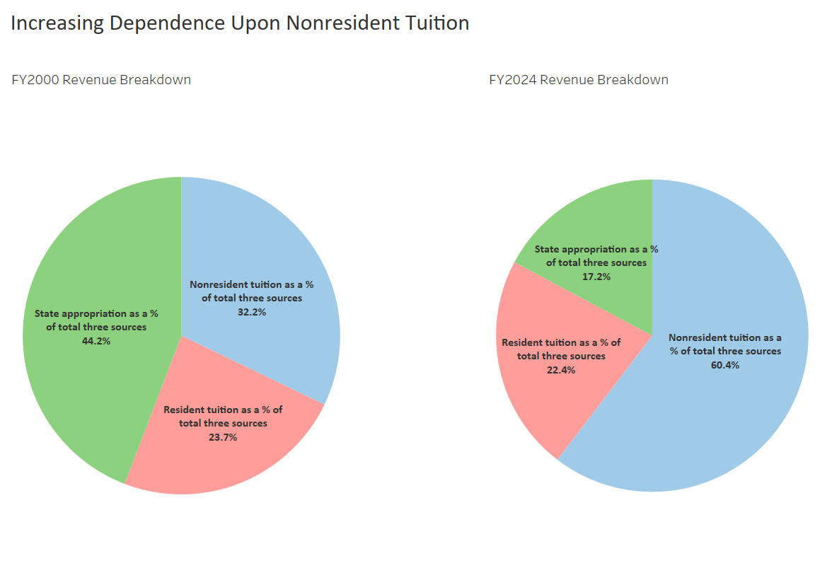

Slide 24
Agenda
Historical & Comparative Data
UO Budget Structure
Key Sources of University Funding
Cost Drivers
E&G Fund Challenges
FY24 and Beyond

Slide 25
UO Budget Structure
E&G Funds
Other Funds
Tuition revenue
State Appropriation
F&A Return
Overhead revenue
Fee revenue, interest earnings
Grants and Contracts revenue
Auxiliary Revenue
Service Center Revenue
Designated Operations Revenue
Restricted gifts
School & College Budgets
Grants & Contracts
Central Admin
Budgets
Plant Funds
Institutional Expenses
(Debt, assessments, utilities, leases)
Auxiliary, Service Centers, and Designated Ops Funds
Restricted Gifts

Slide 26
Summary – Major FY2025 E&G Fund Cost Drivers
Cost Driver | Projected FY25 Cost Increase | Notes
Faculty, Staff and GE Salary and OPE | $13.0 million | E&G employee increases based on historical salary increases (absent contracts in place for bargaining units in future years) for approximately 1,151 graduate employees, 1,472 faculty, and 789 classified staff. Also includes salary increases for approximately 1,154 unrepresented staff. Figures are for employees paid with E&G funds only. Does not include any projected expenses related to adding staff or refilling vacancies.
Medical Costs | $2.5 million | Includes increases of 4.1% on December 1, 2023 and assumes 4.1% on December 1, 2024.
Oregon Paid Leave | $300K | Cost of annualized Oregon Paid Leave not incorporated in FY24 (program began in September 2023)
Institutional Expenses | $2.0 million | Increases related to utilities, insurance, debt for academic buildings, assessments, and leases.
Faculty Hiring | $3.0 million | 15 Net Tenure Track Hires
Strategic Investments | $2.0 million | Allocated via strategic investment process.
Total Projected Cost Increases | $22.8 million
1% Salary Increase | $4.3 million | Every 1% average increase in salaries across all employee classes.

Slide 27
Summary – Major FY2025 E&G Fund Cost Drivers
Cost Driver | FY24 Base | Projected FY25 Cost Increase | FY25% Increase
Faculty, Staff and GE Compensation (Note: FY24 base includes $93.9 million of fixed compensation costs such as health insurance and GE tuition waiver benefits) | $511.0 million | $13.0 million | 2.5%
Medical Costs | $60.4 million | $2.5 million | 4.1%
Retirement Costs | $ 74.4 million | $0 million | 0.0%
Oregon Paid Leave | $511.0 million | $300K | 0.1%
Institutional Expenses | $47 million | $2.0 million | 4.3%
TTF Faculty Hiring | $132.3 million | $3.0 million | 2.3%
Strategic Investments | $645.2 million | $2.0 million | 0.3%
Total (E&G Expenditure Budget) | $645.2 million | $22.8 million | 3.5%

Slide 28
Summary – Major FY2025 E&G Fund Cost Drivers
Cost Driver | Projected FY20 Cost Increase | Projected FY21 Cost Increase | Projected FY22 Cost Increase | Projected FY23 Cost Increase | Projected FY24 Cost Increase | Projected FY25 Cost Increase
Faculty, Staff & GE Salary & Wages | $10.6 million | $11.6 million | $7.3 million | $15.0 million | $11.9 million | $13.0 million
Medical Costs | $1.9 million | $2.5 million | $1.2 million | $1.6 million | $2.2 million | $2.5 million
Retirement Costs | $7.1 million | ($500K) | - | - | $1.9 million | -
Oregon Paid Leave | - | - | - | - | $900K | $300K
Blended OPE | - | - | - | - | $4.0 million | -
Institutional Expenses | $1.0 million | $1.5 million | $1.2 million | $1.2 million | $1.5 million | $2.0 million
Faculty Hiring | - | - | - | - | - | $3.0 million
Strategic Investments | $2.0 million | $2.0 million | $600K | $2.0 million | $2.0 million | $2.0 million
Minimum Wage Increase | $1.0 million | $1.9 million | $320K | $257K | - | -
Total Projected Cost Increases | $23.6 million | $19.0 million | $10.6 million | $20.1 million | $24.4 million | $22.8 million

Slide 29
Agenda
Historical & Comparative Data
UO Budget Structure
Key Sources of University Funding
Cost Drivers
E&G Fund Challenges
FY24 and Beyond

Slide 30
E&G Fund Context
  E&G Fund – Characteristics (FY25)
    Approximately $681 million
    77% funded with tuition revenue
    Funds majority of activity in schools and colleges and administrative units
    79% invested in people
  E&G Fund – Recent History
    FY16, FY17, & FY18: Balanced due to state investments, tuition increases, and budget cuts
    FY19: $11.5 million deficit
    FY20: $7.6 million deficit
    FY21: Balanced budget due to actions taken to mitigate impact of COVID-19.
    FY22, FY23 & FY24: Fund balance increased due to HEERF lost revenue funding and staffing challenges / compensation cost one-time savings

Slide 31
Significant Hiring Occurred During FY23 & FY24
Notes:
Includes Faculty, Librarians, OA, Classified and Post-Doc employee categories on Education and General Funds.
Excludes employees shifted from E&G funds during FY19 to CPFM Service Center in FY19.

Slide 32
E&G Fund Challenge:
Cost and Revenue Dynamics
    79% Invested in People
    Costs
    77% Tuition & Fees Funded
    Revenue

Slide 33
Summary – Major FY2025 E&G Fund Cost Drivers
Cost Driver | Projected FY25 Cost Increase | Notes
Faculty, Staff and GE Salary and OPE | $13.0 million | E&G employee increases based on historical salary increases (absent contracts in place for bargaining units in future years) for approximately 1,151 graduate employees, 1,472 faculty, and 789 classified staff. Also includes salary increases for approximately 1,154 unrepresented staff. Figures are for employees paid with E&G funds only. Does not include any projected expenses related to adding staff or refilling vacancies.
Medical Costs | $2.5 million | Includes increases of 4.1% on December 1, 2023 and assumes 4.1% on December 1, 2024.
Oregon Paid Leave | $300K | Cost of annualized Oregon Paid Leave not incorporated in FY24 (program began in September 2023)
Institutional Expenses | $2.0 million | Increases related to utilities, insurance, debt for academic buildings, assessments, and leases.
Faculty Hiring | $3.0 million | 15 Net Tenure Track Hires
Strategic Investments | $2.0 million | Allocated via strategic investment process.
Total Projected Cost Increases | $22.8 million
  Total Personnel-Related Cost Increase: $18.8 million
  Equates to 3.7 percent annual increase to personnel costs in a year without
  a large PERS increase

Slide 34
E&G Fund Challenge #1 – PERS Costs
Projected Annual Increases | FY18 | FY19 | FY20 | FY21 | FY22 | FY23 | FY24 | FY25
E & G Fund | $7.1M | $0 | $7.1M | $0 | $7.1M | $0 | $1.7M | $0
Other Funds | $3.4M | $0 | $3.0M | $0 | $3.0M | $0 | $0.5M | $0
Total | $10.5M | $0 | $10.1M | $0 | $10.1M | $0 | $2.2M | $0
X
X

Slide 35
Cost and Revenue Dynamics
    79% Invested in People
    Costs
    77% Tuition & Fees Funded
    Revenue

Slide 36
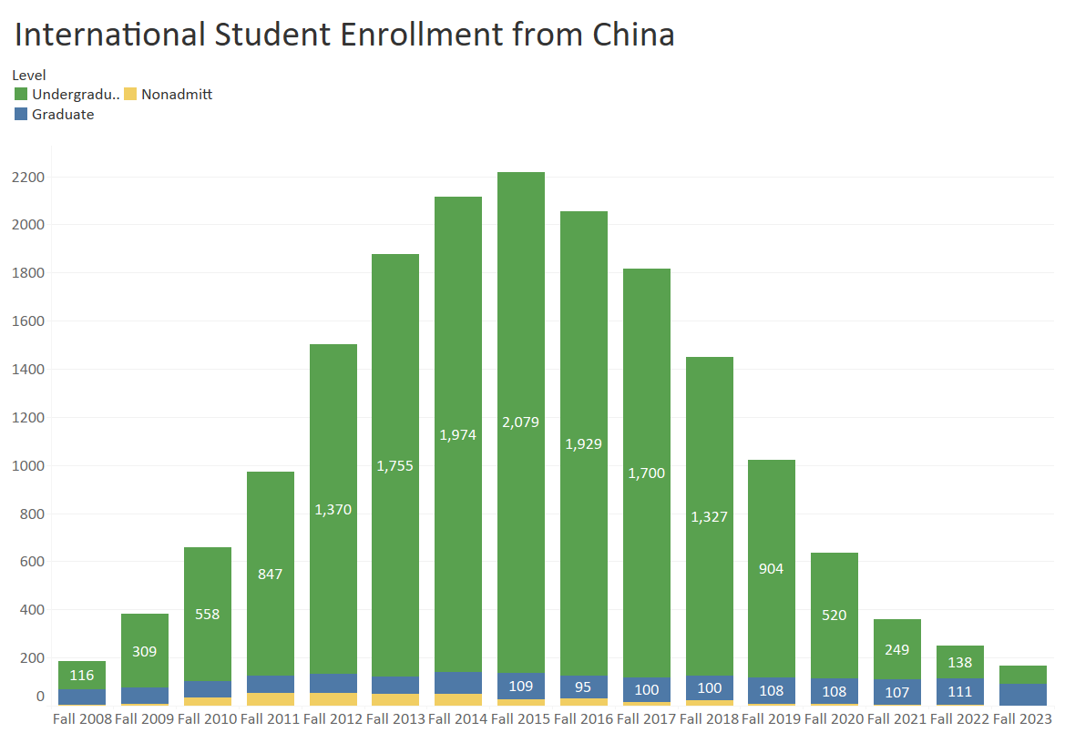


Slide 37
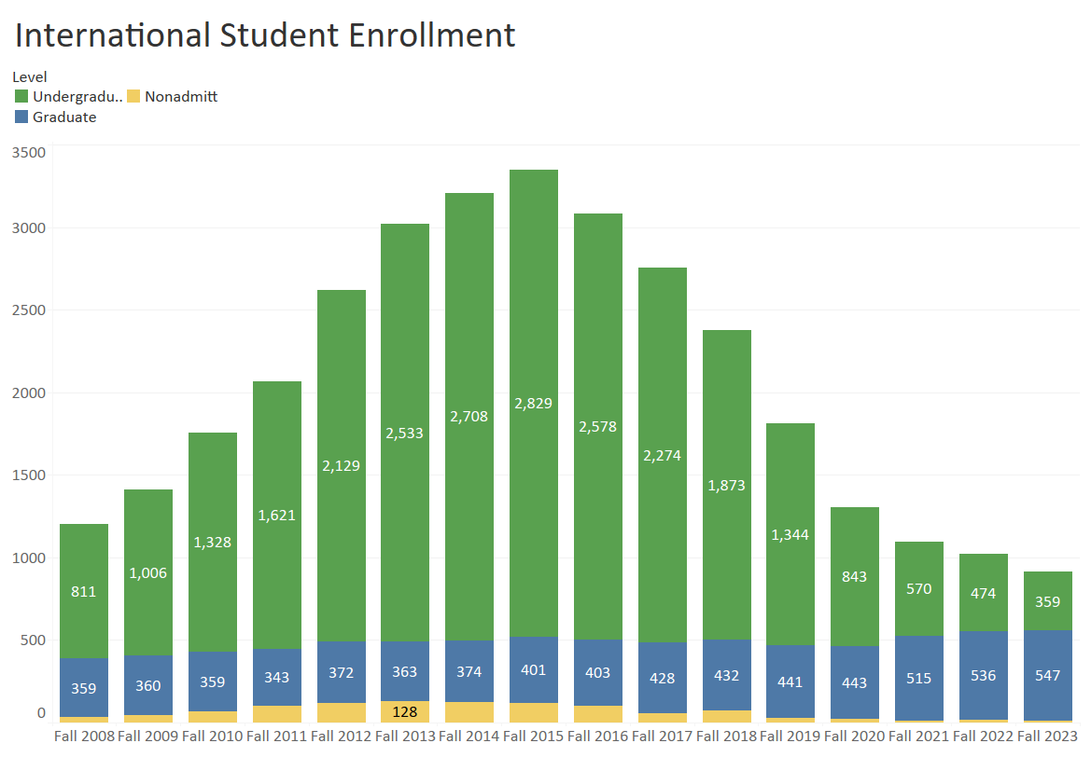

Slide 38
Revenue Impact of Loss of International Students
Source: UO Finance & Administration, September 2023
Notes:
Slide updated with Jamie’s numbers 9/28/23

Slide 39
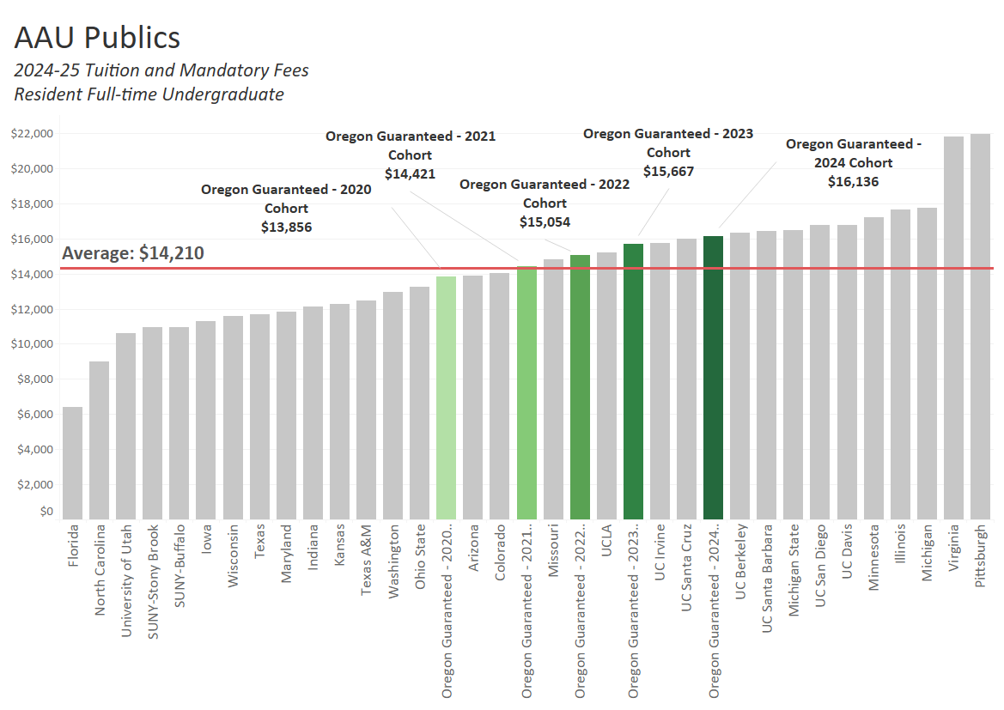

Slide 40
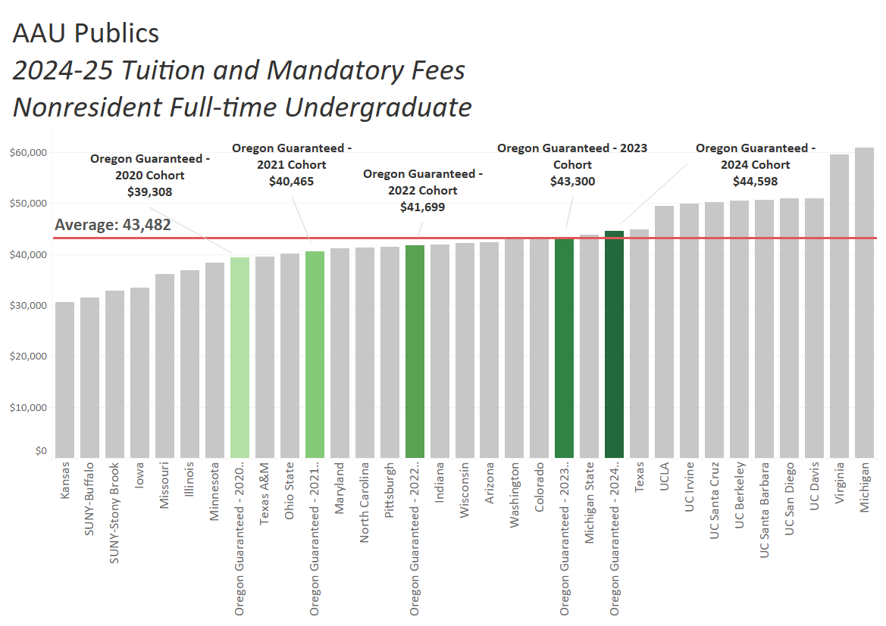

Slide 43
Cost Cutting
    FY2017
      Administrative Cuts - $3.0M
      CAS Cost Cut - $3.3M
    FY2018
      Presidential Directed Cuts- $4.5M
    FY2019:
      Administrative and Academic Cuts: $11.6 million
    Three-year total: $22.4 million per year

Slide 44
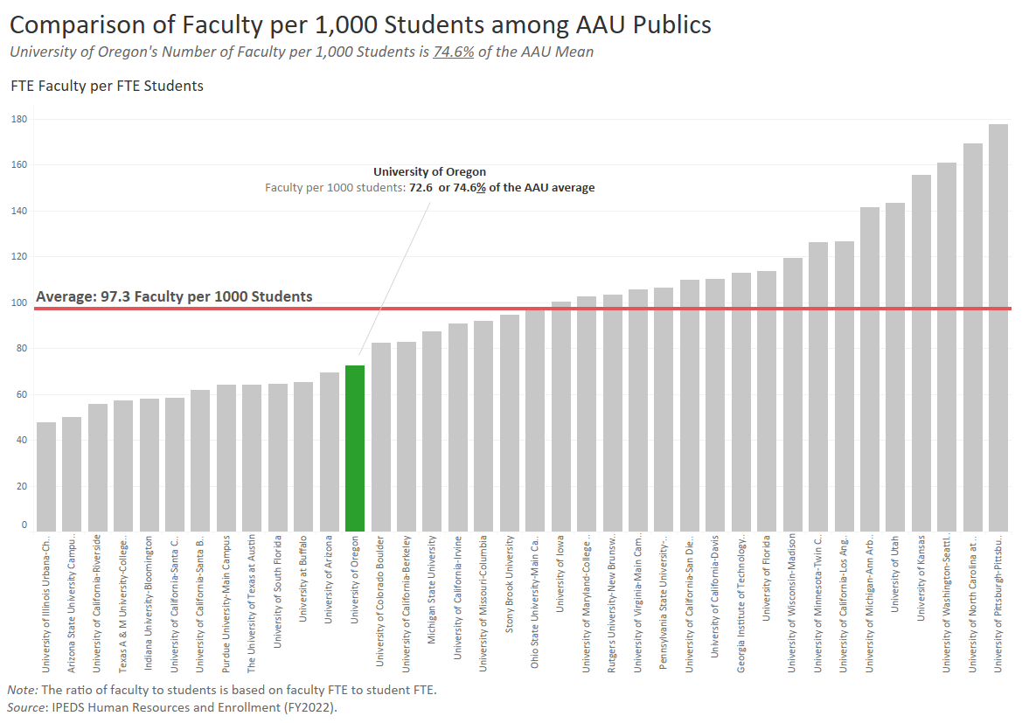

Slide 45
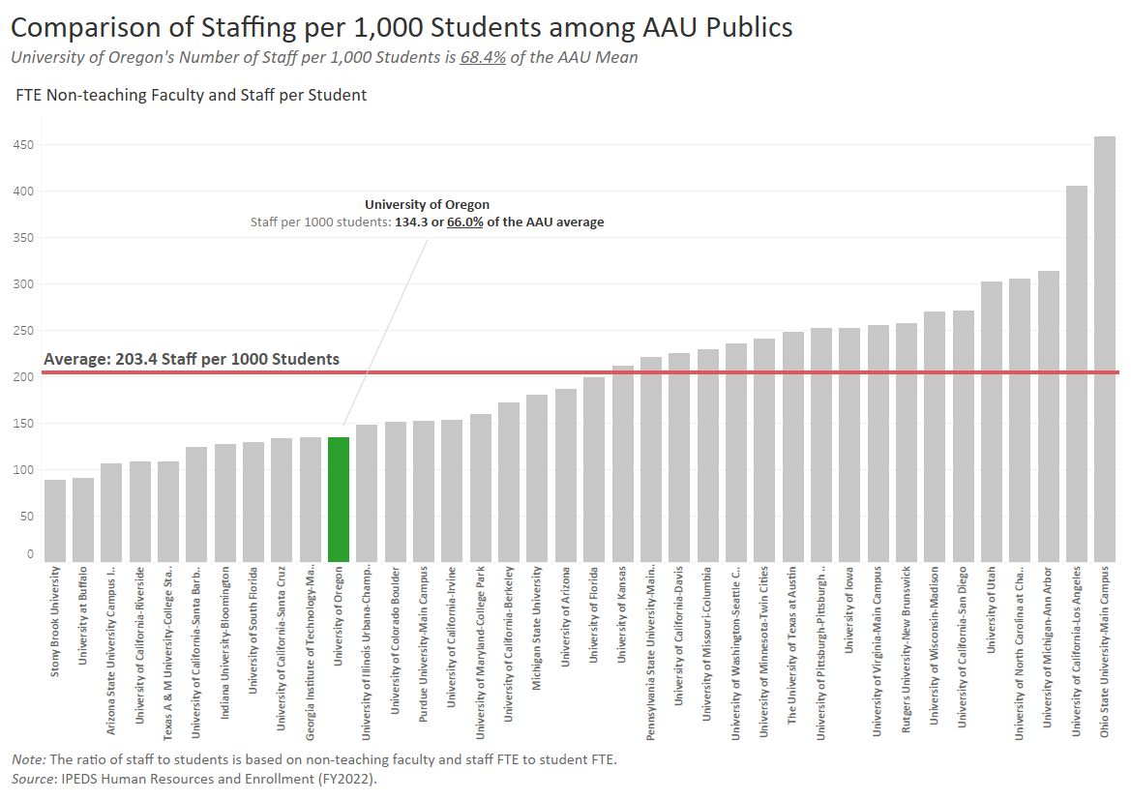

Slide 46
Agenda
Historical & Comparative Data
UO Budget Structure
Key Sources of University Funding
Cost Drivers
E&G Fund Challenges
FY24 and Beyond

Slide 47
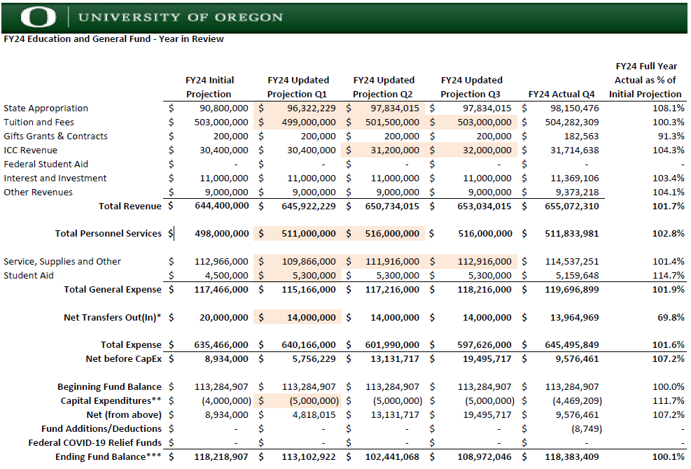
47

Slide 48
FY25 and Beyond
UO is currently in a strong financial position
  During the pandemic, E&G fund balances grew due to one-time Federal HEERF funds and substantial salary savings due to low staffing levels
  While enrollment dropped in Fall of 2020, it has since rebounded
However, the long-term projections reveal a more challenging financial situation
  Hiring rebounded in the second half of FY23 – good news operationally, but eliminates pandemic salary savings
  Fall 2023 & Fall 2024 enrollment environment proved challenging; national student demographic changes and increased recruiting competition will impact enrollment
  After FY25, long term projections show expenses growing at a faster rate than revenue

Slide 49
E&G Fund Balance
 | FY2018 | FY2019 | FY2020 | FY2021 | FY2022 | FY2023 | FY2024
Total Expenses including CapEx | $520.0M | $544.0M | $552.6M | $524.1M | 564.5M | $597.6M | $650.0M
Weekly OpEx | $10.0M | 10.5M | $10.6M | $10.1M | $10.9M | $11.5M | $12.5M
End of Year Fund Balance | $80.0M | $65.4M | $56.7M | $65.3M | $93.3M | $114.3M | $118.4M
Weeks of OpEx | 8.0 | 6.3 | 5.3 | 6.5 | 8.6 | 9.9 | 9.5

