Slide 1
University of Oregon Financial Briefing
DRAFT
November 16th, 2016

Slide 2
Agenda
Background Budget Information
Non-Resident Tuition Dependency
FY15, FY16 and FY17 Budget Issues
FY18 Projected Major Cost Drivers

Slide 3
UO Budget Structure
E&G Funds
Other Funds
Tuition revenue
State Appropriation
F&A Return
Overhead revenue
Fee revenue, interest earnings
Grants and Contracts revenue
Auxiliary Revenue
Service Center Revenue
Designated Operations Revenue
Restricted gifts
School & College Budgets
Grants & Contracts
Central Admin
Budgets
Plant Funds
Institutional Expenses
(Debt, assessments, utilities, leases)
Auxiliary, Service Centers, and Designated Ops Funds
Restricted Gifts

Slide 4
Decreased levels of State Appropriation

Slide 5
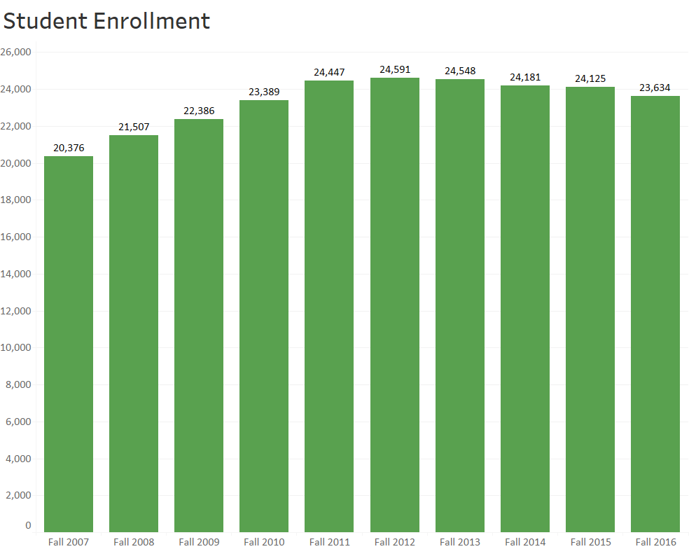

Slide 6
University Resources
FY2016 Major Revenue Streams (E&G Fund)
State Appropriation $64.8 million
Resident Tuition $104.0 million
Nonresident Tuition $281.1 million

Slide 7
Increasing Dependence Upon Nonresident Tuition
FY2004 – Revenue Breakdown
FY2016 – Revenue Breakdown
UO Professional Development http://odt.uoregon.edu

Slide 8
UO Budget Structure
E&G Funds
Other Funds
Tuition revenue
State Appropriation
F&A Return
Overhead revenue
Fee revenue, interest earnings
Grants and Contracts revenue
Auxiliary Revenue
Service Center Revenue
Designated Operations Revenue
Restricted gifts
School & College Budgets
Grants & Contracts
Central Admin
Budgets
Plant Funds
Institutional Expenses
(Debt, assessments, utilities, leases)
Auxiliary, Service Centers, and Designated Ops Funds
Restricted Gifts

Slide 9
Context – E&G Fund
E&G Fund - Characteristics
80% funded with tuition revenue
Funds majority of activity in schools and colleges and administrative units
Over 80% invested in people
E&G Fund – Recent History
FY15: $10 million deficit ($6.5 million related to recurring issues)
FY16: Balanced due to state investment and tuition increase
FY17: Projections balanced due to tuition increase and cost containment efforts
Notes:
Defining how Sightlines breaks up the areas of project funding necessary to maintain a campus.
DM and CR are what this presentation concentrates on.
Definitions taken from APPA (Association of Physical Plant Administrators)

Slide 10
Summary – Major E&G Fund Cost Drivers
Cost Driver | Original Estimates FY18 Cost Increases | Revised Estimates FY18 Cost Increases
Faculty and Staff Salary and Wages | $10.6 million | $11.0 million
GTF Salary and Wages | TBD | $800K
Medical Costs | $2.2 million | $1.6 million
Retirement Costs | $6 million | $7.1 million
Institutional Expenses | $1.5 million | $1.0 million
Strategic Investments (includes $1 million for new faculty) | $2.0 million | $2.0 million
IT Infrastructure Investments | $2.75 million? | TBD
Increase to Minimum Wage | TBD | TBD
Investments in Tenure Track Faculty | $1.5 million | $1.5 million
Total Project Cost Increases* | $26.5 million* | $25.0 million*
*Does not include, increases to minimum wage, costs related to federal FLSA regulations changes regarding eligibility for overtime pay; further investments in diversity initiatives, or individual school/college/department investments.
Notes:
Defining how Sightlines breaks up the areas of project funding necessary to maintain a campus.
DM and CR are what this presentation concentrates on.
Definitions taken from APPA (Association of Physical Plant Administrators)

Slide 11
FY18 E&G Fund Major Cost Drivers
Factor | Projected Cost Increase | Notes
Faculty and Staff Salary and Wages | $11.0 million | Per collective bargaining agreements. Officers of Administration salary package assumed to be similar to faculty salary package. Does not include GTF salary increases
GTF Salary and Wages | $800K | Assumes insurance cost increases only 50% of last year
Medical Cost (PEBB) | $1.6 million | Assumes average 3.4% increase (Dec. 2016 rate) for entire year
Notes:
Defining how Sightlines breaks up the areas of project funding necessary to maintain a campus.
DM and CR are what this presentation concentrates on.
Definitions taken from APPA (Association of Physical Plant Administrators)

Slide 12
FY18 E&G Fund Major Cost Drivers (continued)
Factor | Projected Cost Increase | Notes
Retirement Costs (PERS) | $7.1 million | Based on recently releasd updated PERS information. Assumes 400K of savings as Tier 1&2 employees retire and are replaced with Tier 3 & 4 employees. PERS Board projecting additional significant increases to occur in FY20 and FY22.
Institutional Expenses | $1.0 million | Debt, rent, utilities, insurance and assessments.
Strategic Investment Fund | $2.0 million | $1 million pre-committed to tenure track faculty hires as part of cluster hires.
Notes:
Defining how Sightlines breaks up the areas of project funding necessary to maintain a campus.
DM and CR are what this presentation concentrates on.
Definitions taken from APPA (Association of Physical Plant Administrators)

Slide 13
FY18 E&G Fund Major Cost Drivers (continued)
Factor | Projected Cost Increase | Notes
IT Infrastructure Investments | TBD | Necessary Phase One investments..
Increase to Minimum Wage | TBD | New minimum wage law implemented. Mostly affecting student workers at this point.
Investments in New Tenure Track Faculty | $1.5 million
Notes:
Defining how Sightlines breaks up the areas of project funding necessary to maintain a campus.
DM and CR are what this presentation concentrates on.
Definitions taken from APPA (Association of Physical Plant Administrators)

Slide 14
Summary – Major E&G Fund Cost Drivers
Cost Driver | Revised Estimates FY18 Cost Increases
Faculty and Staff Salary and Wages | $11.0 million
GTF Salary and Wages | $800K
Medical Costs | $1.6 million
Retirement Costs | $7.1 million
Institutional Expenses | $1.0 million
Strategic Investments (includes $1 million for new faculty) | $2.0 million
IT Infrastructure Investments | TBD
Increase to Minimum Wage | TBD
Investments in Tenure Track Faculty | $1.5 million
Total Project Cost Increases* | $25.0 million*
*Does not include, increases to minimum wage, costs related to federal FLSA regulations changes regarding eligibility for overtime pay; further investments in diversity initiatives, or individual school/college/department investments.
Notes:
Defining how Sightlines breaks up the areas of project funding necessary to maintain a campus.
DM and CR are what this presentation concentrates on.
Definitions taken from APPA (Association of Physical Plant Administrators)

Slide 15
Current Service Level Analysis
Sample Figures Only for Easy Math
FY16 / FY17 - $100 million
FY18 / FY19 - $103 million
3.0%
CSL
FY2016
$49 M
FY2017
$51M
FY2018
$50.5M
-1.0%
FY2019
$52.5M
4.0%
FY16 / FY17 - $100 million
FY18 / FY19 - $108 million
7.9%
CSL
FY2016
$49 M
FY2017
$51M
FY2018
$52.9
3.8%
FY2019
$55.1M
4.2%
Notes:
Defining how Sightlines breaks up the areas of project funding necessary to maintain a campus.
DM and CR are what this presentation concentrates on.
Definitions taken from APPA (Association of Physical Plant Administrators)

