Slide 1
Student Tuition Forum Financial Briefing
January 17th, 2023

Slide 2
Agenda
Cost Drivers
State Appropriation
Guaranteed Tuition Program
Info and Input on Tuition
Small Group Discussion

Slide 3
Summary – Major FY2024 E&G Fund Cost Drivers
Cost Driver | Projected FY24 Cost Increase | Notes
Faculty, Staff and GE Salary and OPE | $11.9 million | E&G employee increases based on collective bargaining agreements for approximately 1,216 graduate employees, 1,471 faculty, and 700 classified staff. Also includes salary increases for approximately 1,085 unrepresented staff. Figures are for employees paid with E&G funds only. Does not include any projected funding for retention, equity or market adjustments or funds needed for refilling staffing vacancies.
Medical Costs | $2.2 million | Includes weighted average increase of 4.2% for December 2022 and assumes 4.2% increase in December 2023.
Retirement Costs | $1.9 million | Increases for PERS for FY24
Oregon Paid Leave | $900K | Oregon Paid leave program starting in FY24 - September
Blended OPE | $4.0 million | Blended OPE rates artificially low in FY23 due to extremely low level of leave usage in FY21. Rates renormalizing in FY24.
Institutional Expenses | $1.5 million | Increases related to utilities, insurance, debt for academic buildings, assessments, and leases.
Strategic Investments | $2.0 million | Allocated via strategic investment process.
Total Projected Cost Increases | $24.4 million

Slide 4
Summary – Major FY2024 E&G Fund Cost Drivers
Cost Driver | FY23 Base | Projected FY24 Cost Increase | FY24% Increase
Faculty, Staff and GE Salary and Wages | $467.5 million | $11.9 million | 2.5%
Medical Costs | $52.9 million | $2.2 million | 4.2%
Retirement Costs | $62.5 million | $1.9 million | 3.0%
Oregon Paid Leave | $467.5 million | $900K | 0.2%
Blended OPE | $187.4 million | $4.0 million | 2.1%
Institutional Expenses | $36.7 million | $1.5 million | 4.1%
Strategic Investments | $606.0 million | $2.0 million | 0.3%
Totals | $606.0 million | $24.4 million | 4.0%

Slide 5
Summary – Major FY2024 E&G Fund Cost Drivers
Cost Driver | Projected FY20 Cost Increase | Projected FY21 Cost Increase | Projected FY22 Cost Increase | Projected FY23 Cost Increase | Projected FY24 Cost Increase
Faculty, Staff and GE Salary and Wages | $10.6 million | $11.6 million | $7.3 million | $15.0 million | $11.9 million
Medical Costs | $1.9 million | $2.5 million | $1.2 million | $1.6 million | $2.2 million
Retirement Costs | $7.1 million | ($500K) | - | - | $1.9 million
Oregon Paid Leave | - | - | -- | - | $900K
Blended OPE | - | -- | - | - | $4.0 million
Institutional Expenses | $1.0 million | $1.5 million | $1.2 million | $1.2 million | $1.5 million
Strategic Investments | $2.0 million | $2.0 million | $600K | $2.0 million | $2.0 million
Minimum Wage Increase | $1.0 million | $1.9 million | $320K | $257K | -
Total Projected Cost Increases | 23.6 million | $19.0 million | $10.6 million | $20.1 million | $24.4 million

Slide 6
Agenda
Cost Drivers
State Appropriation
Guaranteed Tuition Program
Info and Input on Tuition
Small Group Discussion

Slide 7
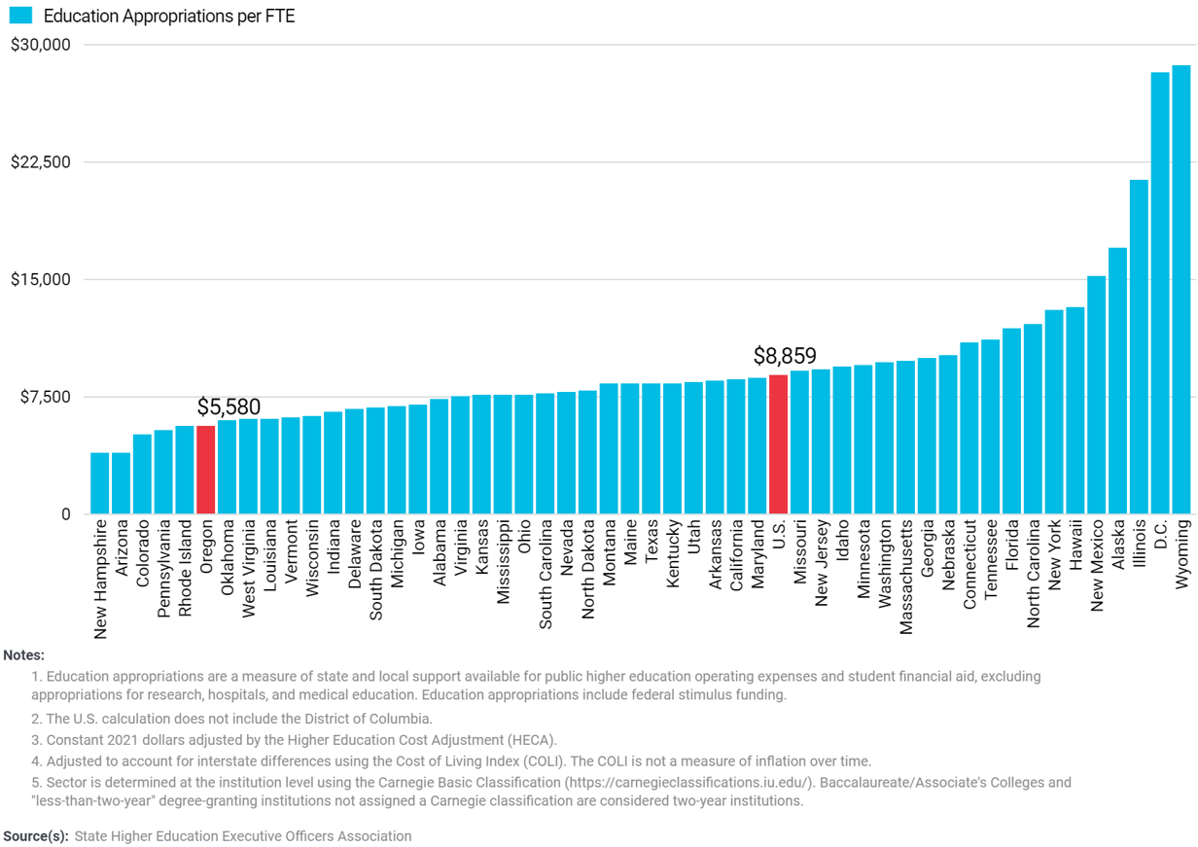
Public Higher Education Appropriations per FTE by State at
Four-Year Institutions, FY2021 (Adjusted)

Slide 8
Comparative University Funding
FY 2022 | EOU | OIT | OSU | PSU | SOU | UO | WOU | Total
Fundable Students (Fall 2021) | 1,319 | 2,343 | 15,675 | 12,977 | 2,167 | 10,733 | 2,671 | 47,884
PUSF Funding | $21.5M | $28.3M | $141.0M | $110.8M | $26.0M | $82.7M | $30.7M | $441.0M
PUSF Funding Per FTE Resident Student | $16,312 | $12,083 | $8,994 | $8,540 | $11,979 | $7,706 | $11,497 | $9,210
Total FY 2022 State Funding | $25.0M | $34.1M | $259.9M | $130.4M | $28.1M | $87.8M | $33.2M | $598.5M
State Funding per FTE Resident Student | $18,962 | $14,565 | $16,582 | $10,049 | $12,946 | $8,180 | $12,425 | $12,498

Slide 9
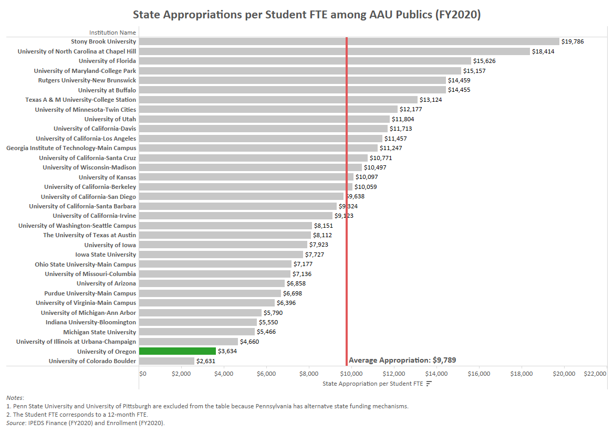

Slide 11
Agenda
Cost Drivers
State Appropriation
Guaranteed Tuition Program
Info and Input on Tuition
Small Group Discussion

Slide 12
Framework – Guaranteed Tuition Program
for Undergraduate Students
For each entering class year, there is a set resident and non-resident tuition rate per student credit hour (SCH)
That rate is guaranteed or locked for five years - no matter what
Other tuition and fees that are locked include administratively controlled mandatory fees, summer tuition, honors college differential tuition, business school differential tuition and the international student fee
Students know the expected cost of their education before they decide to come to the University of Oregon

Slide 13
Average Historical Annual Undergraduate Tuition Rate Increases – Analysis conducted in FY2020
10 Year Average
5 Year Average
Resident
5.4%
5.0%
Non-resident
4.4%
3.3%

Slide 14
New Resident Undergraduate Students Graduation Time 4 yrs Analysis Conducted in FY2020 Assumed Annual Increases 5% - Average 5 Year Historical Rate 5 year Guaranteed rate $254.62 per SCH (9.75% increase)
Total Tuition
Paid
$1,050
Total Tuition
Paid
$1,018

Slide 15
New Resident Undergraduate Students Graduation Time 5 yrs Analysis Conducted in FY2020 Assumed Annual Increases 5% - Average 5 Year Historical Rate 5 year Guaranteed rate $254.62 per SCH (9.75% increase)
Total Tuition
Paid
$1,346
Total Tuition
Paid
$1,273

Slide 16
New Resident Undergraduate Students Graduation Time 8 yrs Analysis Conducted in FY2020 Assumed Annual Increases 5% - Average 5 Year Historical Rate 5 year Guaranteed rate $254.62 per SCH (9.75% increase)
Total Tuition
Paid
$2,326
Total Tuition
Paid
$2,116

Slide 17
Advantages of Guaranteed Tuition Program for Students
Financial Predictability: Tuition rates are locked in for five years – students and their families know ahead of time exactly what they are going to pay for their education.
Peace of Mind: The guaranteed tuition program functions as a insurance policy for students. Regardless of what happens to state funding or other costs, their tuition rates are guaranteed for five years.
Protection of Scholarship Value: Many scholarships are currently fixed dollar amounts. Under a guaranteed tuition program, the value of these scholarships remains the same over their college career.

Slide 18
Advantages of Guaranteed Tuition Program for Institution
Recruiting: The stronger value proposition of a locked-in rate should be very attractive to new students. This should help support the institution’s enrollment growth initiative.
Retention: One of the main reasons students cite for dropping out of school is financial pressure. This can often be linked to students not anticipating tuition increases throughout their college career. Having a locked rate for tuition should help with this issue.
Campus Climate: Concern about continually rising tuition rates affects students, faculty and staff, and directs time, energy and focus away from other important educational issues.

Slide 19
Students who started prior to the Tuition Guarantee Program
Annual tuition increases for undergraduate students who started prior to the Guaranteed Tuition Program will be locked at 3.0% per year through FY2024
ANNUAL TUITION INCREASES FOR CURRENT STUDENTS LOCKED AT 3.0% PER YEAR
 | FY2021 SCH Rate | FY2022 SCH Rate | FY2023 SCH Rate | FY2024 SCH Rate
Resident Undergraduates | $238.96 | $246.13 | $253.51 | $261.12
Non-resident Undergraduates | $785.89 | $809.47 | $833.75 | $858.76

Slide 20
Tuition and Fee Advisory Board (TFAB) Process
Fall term: TFAB was provided with training on
Historical and comparative data and UO budget information
Background on the Public University Support Fund (PUSF)
Impact of COVID-19, Guaranteed Tuition Program, cost drivers, long-term financials, and a plan for cost management
Winter term:
Student Forum on tuition (co-hosted with ASUO)
TFAB reviews proposals: administratively-controlled mandatory fees (EMU, recreation center, health services, tech fee), course fees, housing, graduate programs, and other proposals received
TFAB makes recommendations to the president
President receives input at the President’s tuition forum
President’s tuition recommendations posted for community comment
President finalizes recommendations for March Board meeting

Slide 21
Opportunities for Learning and Input
UO tuition website: https://tuition.uoregon.edu
Input to TFAB during meetings (all open to the public): https://tuition.uoregon.edu/tfab-schedule
Input to ASUO
President’s forum in February to receive input on tuition recommendations
Community survey input to the President following release of TFAB recommendations in Feb

Slide 22
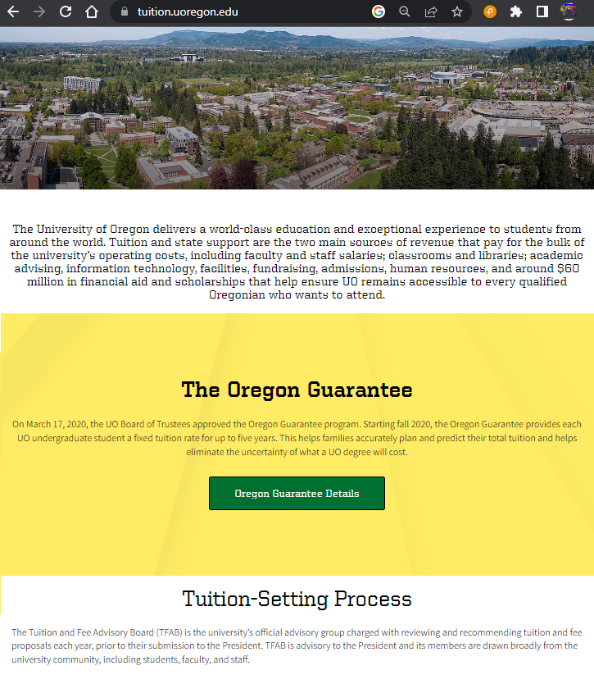
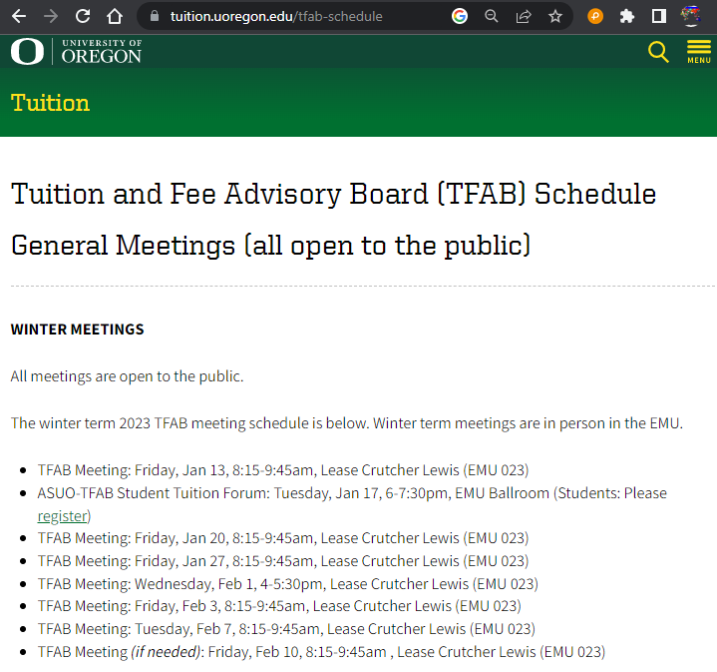
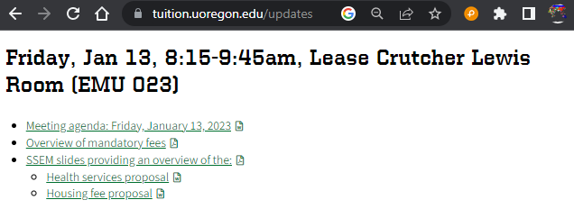
Tuition Website

Slide 23
Agenda
Cost Drivers
State Appropriation
Guaranteed Tuition Program
Info and Input on Tuition
Small Group Discussion

