Slide 1
University of Oregon Tuition and Fee Advisory Board
Information Services – Technology (Tech) Fee
Presented by: Abhijit Pandit, Vice President for Information Services and Chief Information Officer

Slide 2
Agenda
Summary
Tech fee use
Governance and decision-making process
Financial drivers

Slide 3
High Level Summary
Tech Fee Used for
Technology Infrastructure End of life/Growth
Mission Critical Software
Cyber Security tools
Provost reviews IT Steering Committee*
recommendations and provides final approval
Main Cost Drivers
The disproportionate impact of supply chain issues and inflation on the cost of hardware and services
Increased dependency on technology
Current funding levels don’t meet demands
Tech Fee Initiated 2017 - $50/Term.
Current fee - $53/Term.
Proposed Fee - $59.25/Term.
*During COVID IS Exec Council has been providing recommendations

Slide 4
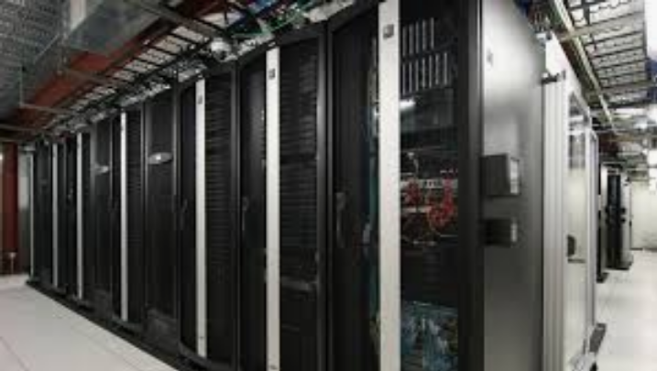
How is the tech fee used?
Cybersecurity tools
Student technology fee:
Currently:
$53.00 per term
Proposed for 2023-24:
$59.25 per term
Applies to:
New, incoming undergrads
All graduate students
Continuing undergrads who started before summer 2020: $55/Term (3.8%)
Infrastructure end of life/growth
Mission critical software
Tech Fee 2017: $50. In 6 years, assuming an annual inflation rate of 3%: $59.70

Slide 5
Tech fee governance and decision making
Proposals are gathered throughout year, prioritized by highest needs, risks
Provost reviews IT Steering Committee recommendations, provides final approval*
IT Steering Committee (includes student rep) reviews and recommends funding
*During COVID IS Exec Council has been providing recommendations

Slide 6
Cost drivers for IT
Increasing dependence on technology
Current funding levels don’t meet demands
The disproportionate impact of supply chain issues and inflation on the cost of hardware and services
Inflation means that over time, we have less purchasing power, creating risks for the university due to aging tech*
*Tech Fee 2017: $50. In 6 years, assuming an annual inflation rate of 3%: $59.70
Notes:
Inflation means that over time, we have less purchasing power, creating risks for the university due to aging tech

Slide 7
Questions?

