Slide 1
University of Oregon Financial Briefing
November 4th, 2022
Tuition and Fee Advisory Board

Slide 2
Agenda
UO Budget Structure
Key Sources of University Funding
Cost Drivers
E&G Fund Challenges
Impact of COVID-19 on University Finances
Part One
Part Two

Slide 3
UO Budget Structure
E&G Funds
Other Funds
Tuition revenue
State Appropriation
F&A Return
Overhead revenue
Fee revenue, interest earnings
Grants and Contracts revenue
Auxiliary Revenue
Service Center Revenue
Designated Operations Revenue
Restricted gifts
School & College Budgets
Grants & Contracts
Central Admin
Budgets
Plant Funds
Institutional Expenses
(Debt, assessments, utilities, leases)
Auxiliary, Service Centers, and Designated Ops Funds
Restricted Gifts

Slide 4
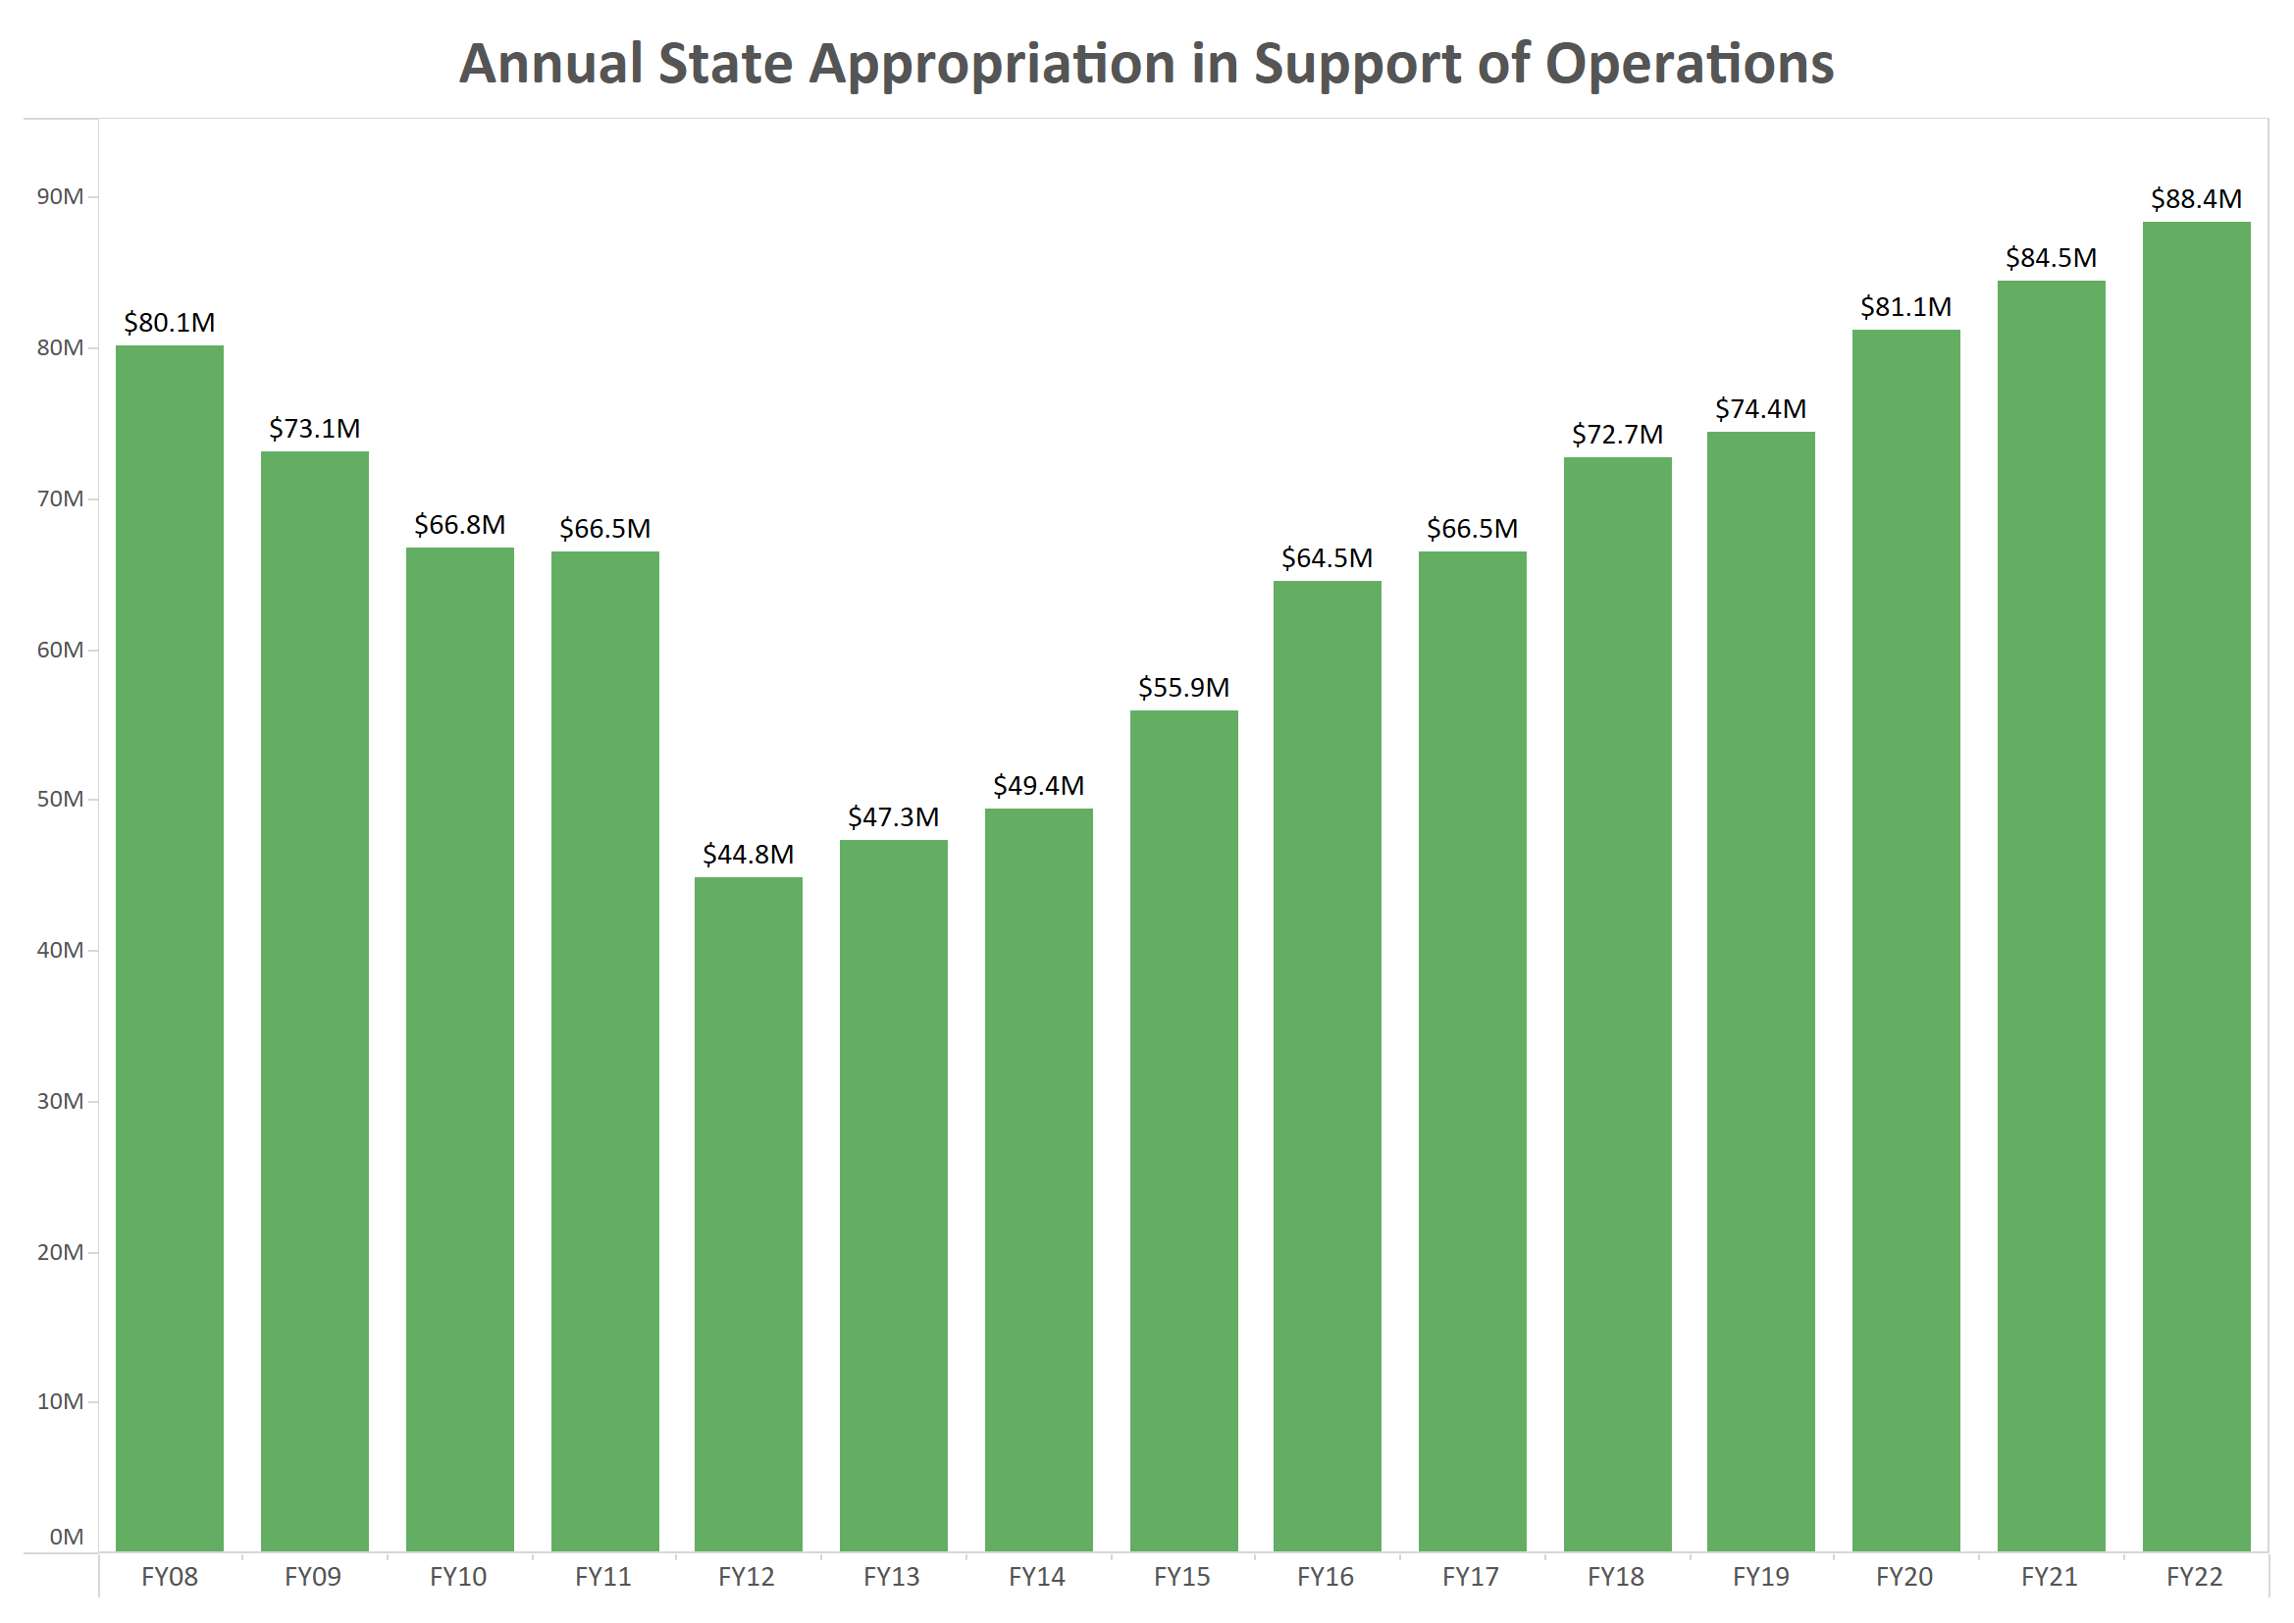

Slide 9
University Resources FY2022 Major Revenue Streams (E&G Fund – Net of Remissions)
State Appropriation $86.6 million
Resident Tuition $114.5 mill
Resident Net Tuition $123.0 million
Non-resident Net Tuition $295.8 million

Slide 10
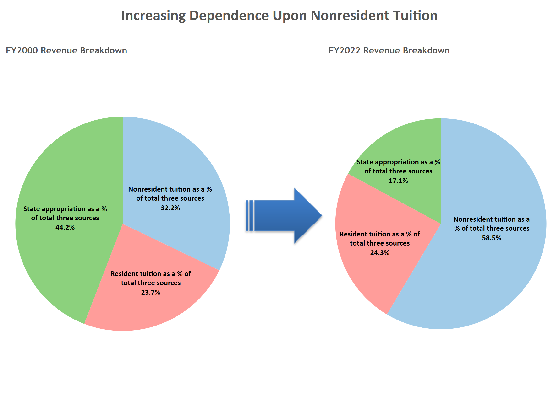

Slide 11
Agenda
UO Budget Structure
Key Sources of University Funding
Cost Drivers
E&G Fund Challenges
Impact of COVID-19 on University Finances
Part One
Part Two

Slide 12
UO Budget Structure
E&G Funds
Other Funds
Tuition revenue
State Appropriation
F&A Return
Overhead revenue
Fee revenue, interest earnings
Grants and Contracts revenue
Auxiliary Revenue
Service Center Revenue
Designated Operations Revenue
Restricted gifts
School & College Budgets
Grants & Contracts
Central Admin
Budgets
Plant Funds
Institutional Expenses
(Debt, assessments, utilities, leases)
Auxiliary, Service Centers, and Designated Ops Funds
Restricted Gifts

Slide 13
Summary – Major FY2023 E&G Fund Cost Drivers
Cost Driver | Projected FY23 Cost Increase | Notes
Faculty, Staff and GE Salary and OPE | $15.0 million | E&G employee increases based on collective bargaining agreements for approximately 1,170 graduate employees, 1,663 faculty, and 662 classified staff. Also includes salary increases for approximately 1,098 unrepresented staff. Figures are for employees paid with E&G funds only.
Medical Costs | $1.6 million | Includes annual weighted increase of 3.1% for December 2021. December 2022 increase assumed to be 3.0%.
Institutional Expenses | $1.2 million | Increases related to utilities, insurance, debt for academic buildings, assessments, and leases.
Strategic Investments | $2 million | Allocated via strategic investment process.
Minimum Wage Increase | $257K | Increases per State of Oregon minimum wage increase to $14.11/hr including associated OPE. Mainly affects student positions
Total Projected Cost Increases | $20.1 million

Slide 14
Summary – Major FY2023 E&G Fund Cost Drivers
Cost Driver | FY22 Base | Projected FY23 Cost Increase | FY23 % Increase
Faculty, Staff and GE Salary and Wages | $452.4 million | $15.0 million | 3.3%
Medical Costs | $54.0 million | $1.6 million | 3.0%
Institutional Expenses | $36.0 million | $1.2 million | 3.3%
Strategic Investments | $564.2 million | $2.0 million | 0.4%
Minimum Wage Increase | $452.4 million | $257K | 0.1%
Totals | $564.2 million | $20.1 million | 3.56%

Slide 15
Summary – Major FY2023 E&G Fund Cost Drivers
Cost Driver | Projected FY20 Cost Increase | Projected FY21 Cost Increase | Projected FY22 Cost Increase | Projected FY23 Cost Increase
Faculty, Staff and GE Salary and Wages | $10.6 million | $11.6 million | $7.3 million | $15.0 million
Medical Costs | $1.9 million | $2.5 million | $1.2 million | $1.6 million
Retirement Costs | $7.1 million | ($500K) | - | -
Institutional Expenses | $1.0 million | $1.5 million | $1.2 million | $1.2 million
Strategic Investments | $2.0 million | $2.0 million | $600K | $2.0 million
Minimum Wage Increase | $1.0 million | $1.9 million | $320K | $257K
Total Projected Cost Increases | $23.6 million | $19.0 million | $10.6 million | $20.1 million

Slide 16
Agenda
UO Budget Structure
Key Sources of University Funding
Cost Drivers
E&G Fund Challenges
Impact of COVID-19 on University Finances
Part One
Part Two

Slide 17
E&G Fund Context
E&G Fund – Characteristics (FY22)
Approximately $577 million
77% funded with tuition revenue
Funds majority of activity in schools and colleges and administrative units
78% invested in people
E&G Fund – Recent History
FY16, FY17, & FY18: Balanced due to state investments, tuition increases, and budget cuts
FY19: $11.5 million deficit
FY20: $7.6 million deficit
FY21: Balanced budget due to actions taken to mitigate impact of COVID-19.
FY22: Fund balance increased due to HEERF lost revenue funding and staffing challenges / compensation cost one-time savings

Slide 18
E&G Fund Challenge #1 – PERS Costs
Projected Annual Increases | FY18 | FY19 | FY20 | FY21 | FY22
E & G Fund | $7.1M | $0 | $7.1M | $0 | $7.1M
Other | $3.4M | $0 | $3.0M | $0 | $3.0M
Total | $10.5M | $0 | $10.1M | $0 | $10.1M
X
Projected Cumulative PERS Increases
$40M
$30M
$20M
X
$10M
$0

Slide 19
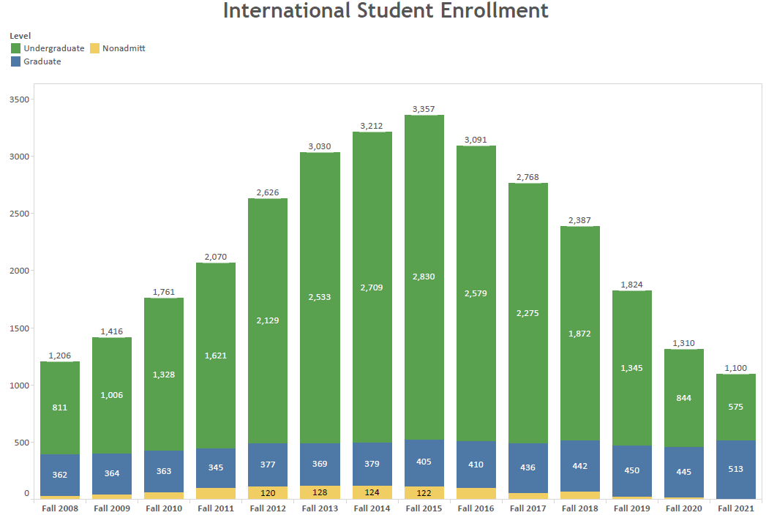
E&G Fund Challenge #2 – International Students

Slide 20
Revenue Impact of Loss of International Students
Source: UO Finance & Administration, July 2022

Slide 21
E&G Fund Challenge #3: Revenue and Cost Dynamics
Revenue
77% Tuition & Fees Funded
78% Invested in People
Costs

Slide 22
Cost Dynamics – Personnel Costs
Cost Driver | FY23 Cost Increase | FY23 Percentage Increase | Notes
Faculty, Staff, & GE Salary and Wages | $15.0 million | 3.3% | E&G employee increases based on collective bargaining agreement for approximately 1,170 graduate employees. Also includes estimates of increases for approximately 1,663 faculty, 662 classified staff and 1,098 unrepresented staff. Figures are for employees paid with E&G funds only.
Medical Costs | $1.6 million | 3.0% | Assumed annual increase of 3.7%
Minimum Wage Increase | $257K | 0.1% | Increases per State of Oregon minimum wage increase to $14.11/hr including associated OPE. Mainly impacts student positions.
Total Personnel-Related Cost Increase: $16.86 million
Equates to 3.73 percent annual increase to personnel costs in a year without a PERS increase

Slide 23
E&G Fund: Revenue and Cost Dynamics
Revenue
77% Tuition & Fees Funded
78% Invested in People
Costs

Slide 24
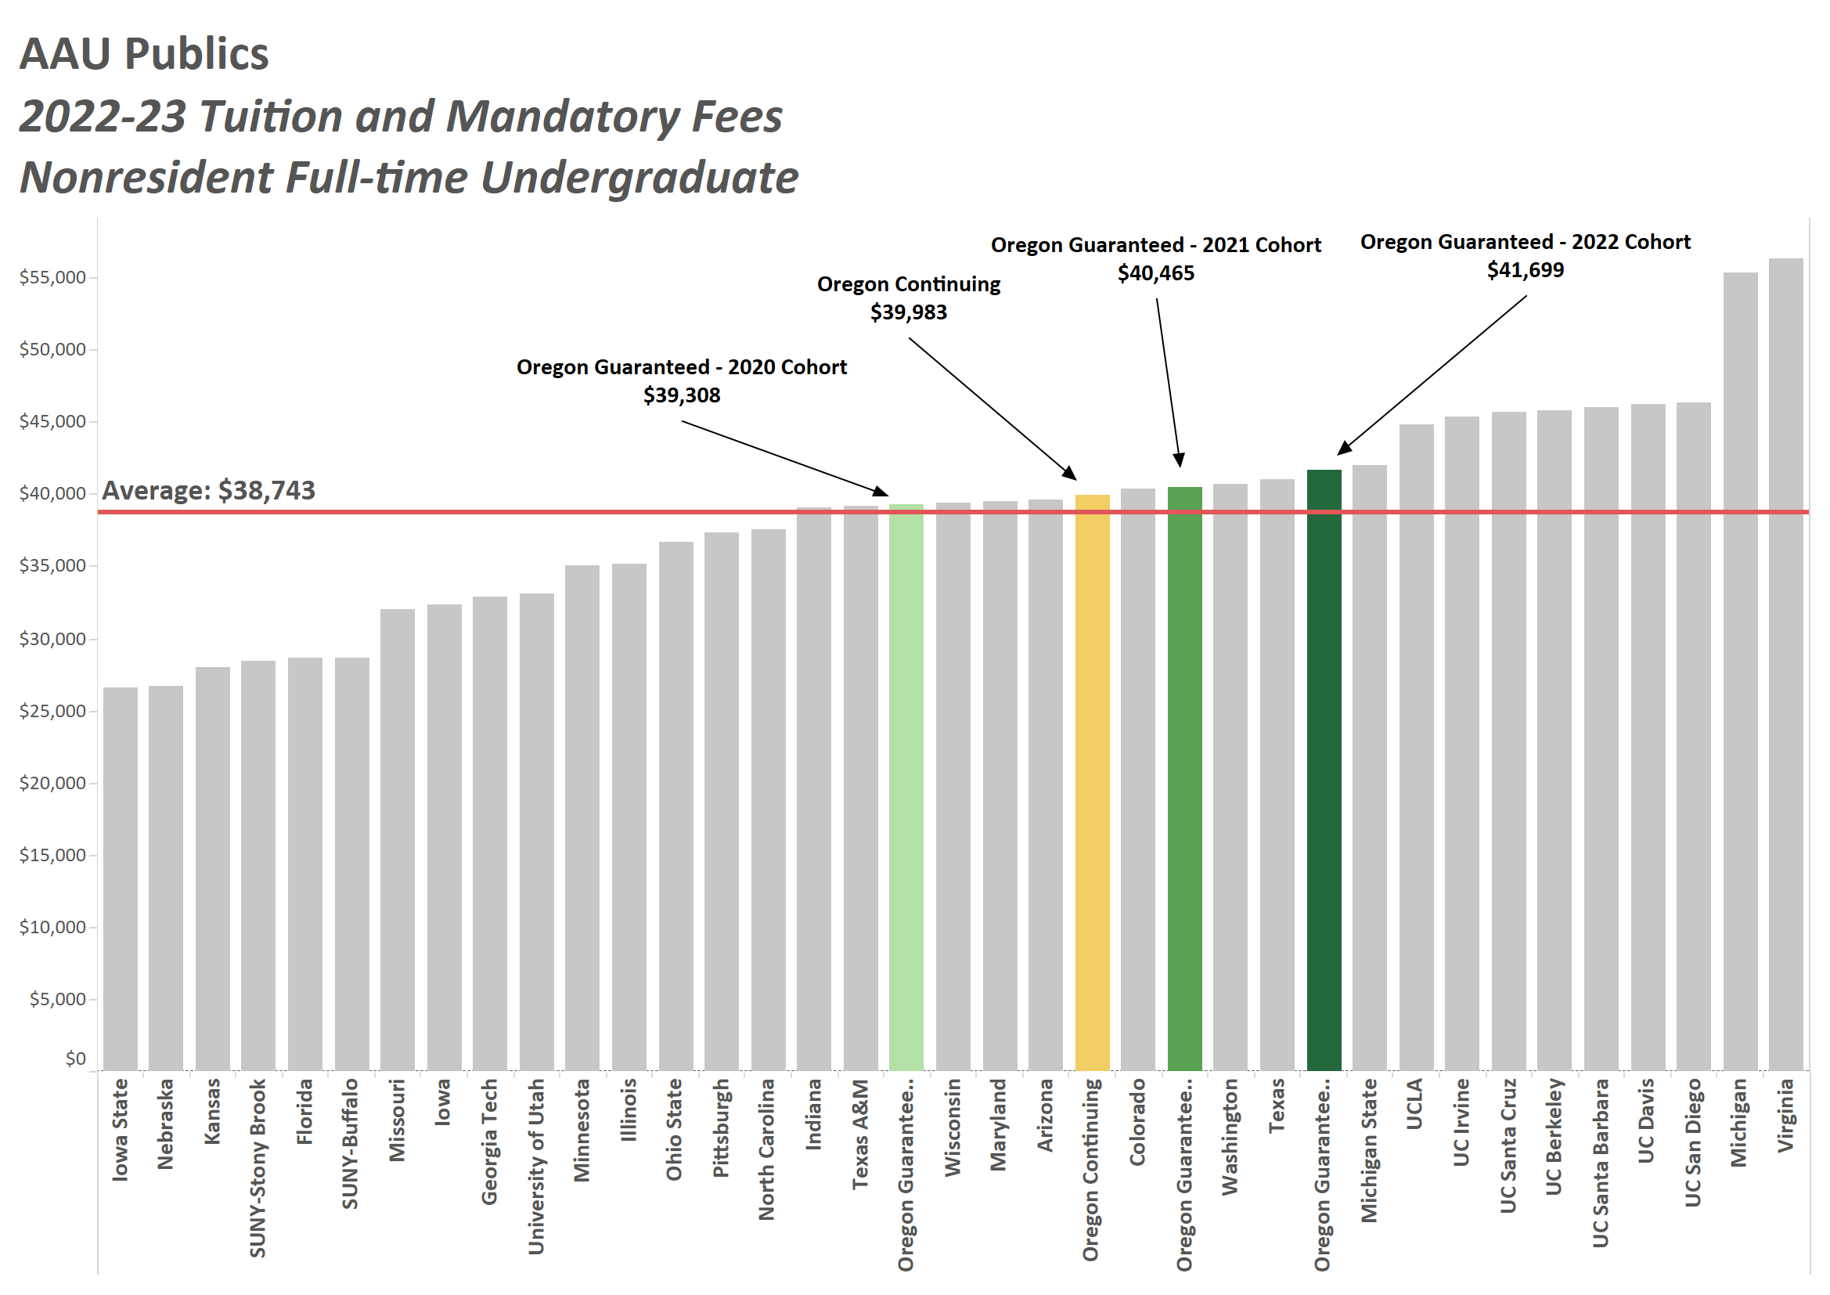

Slide 25
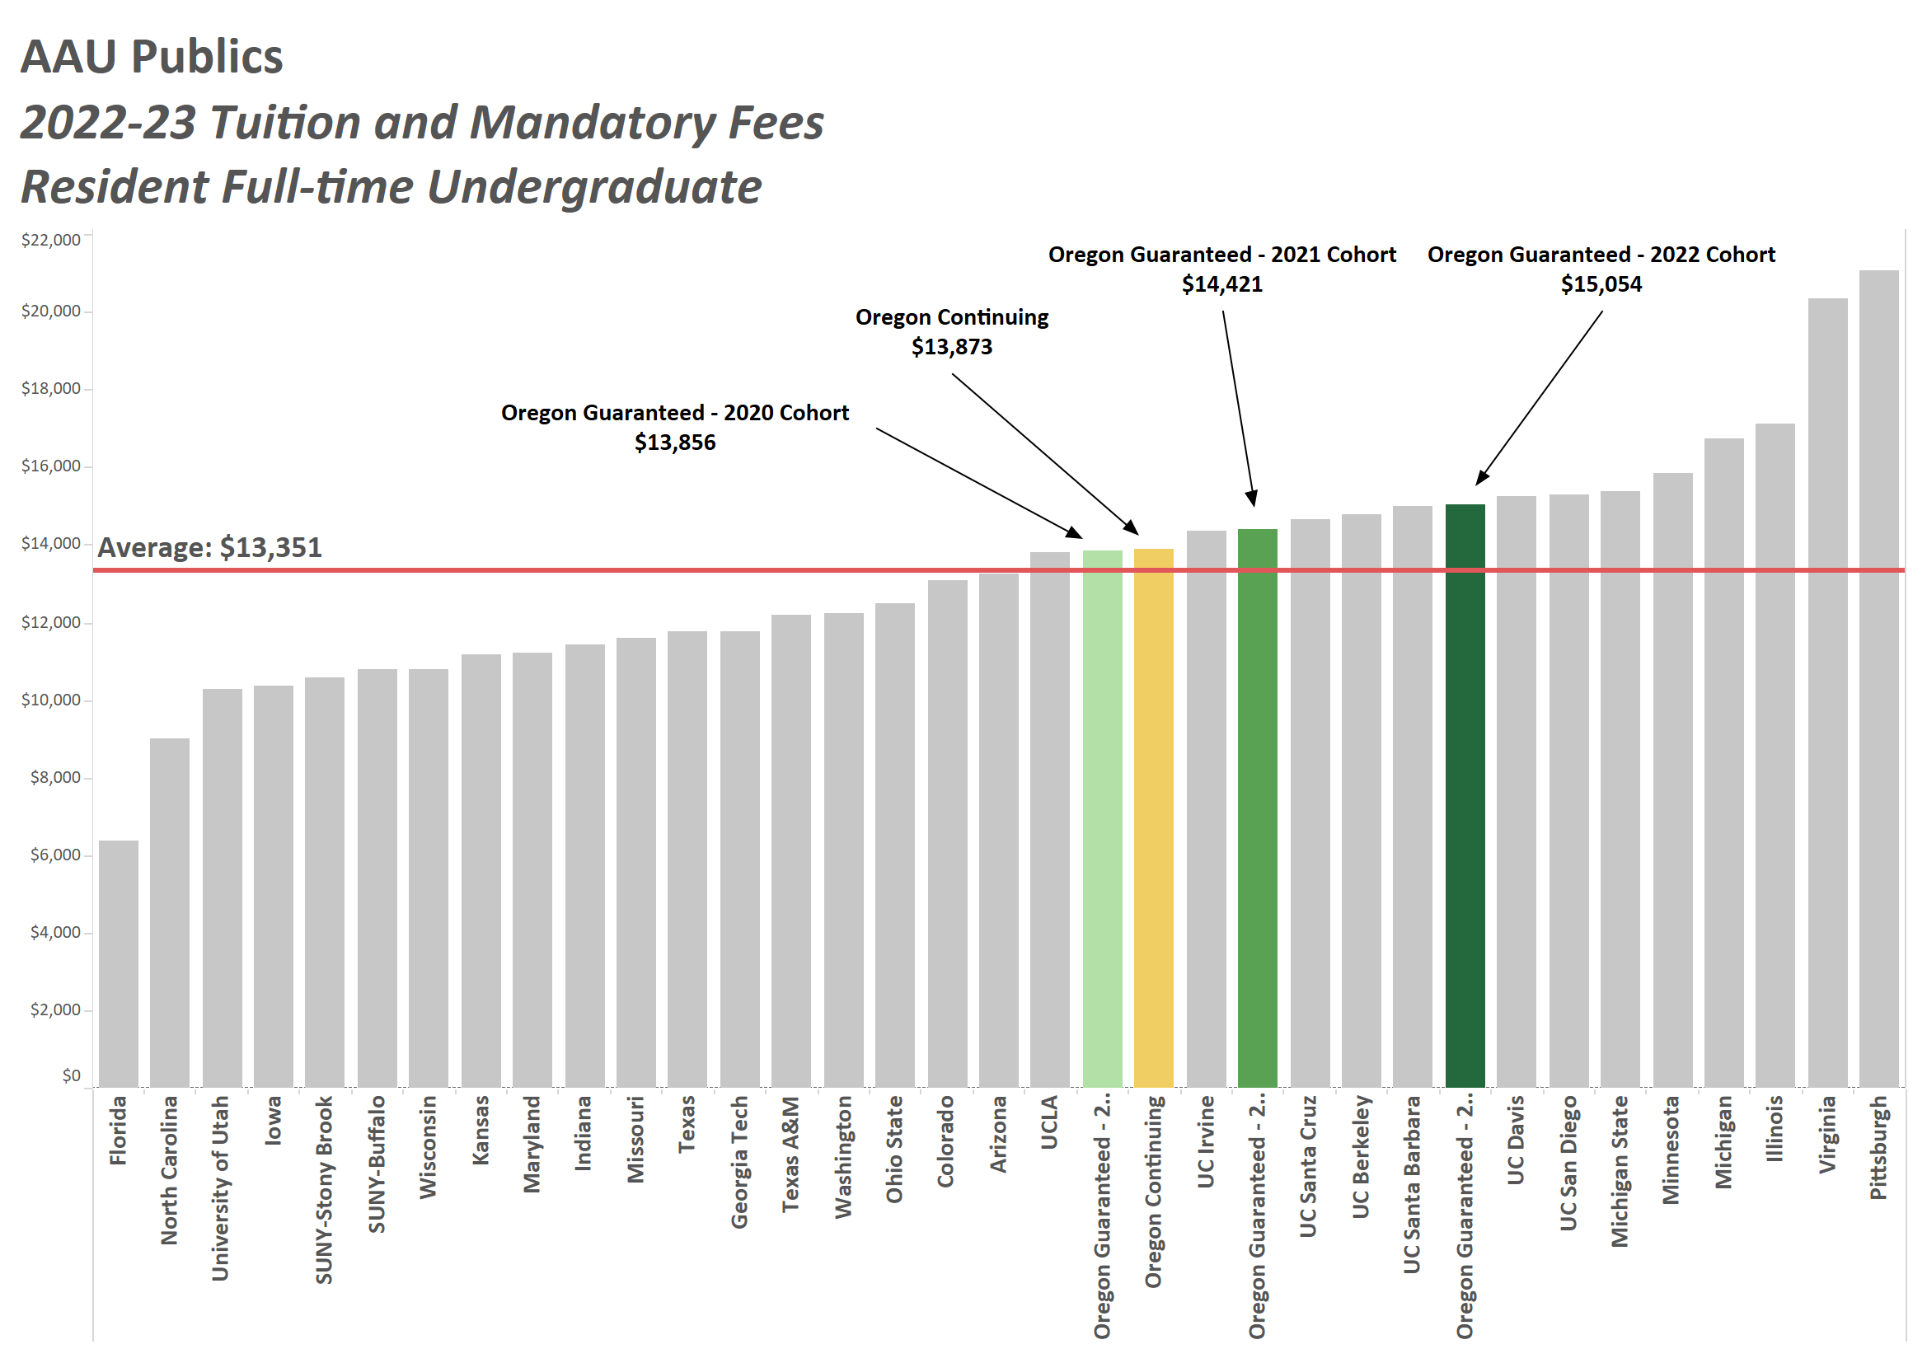

Slide 26
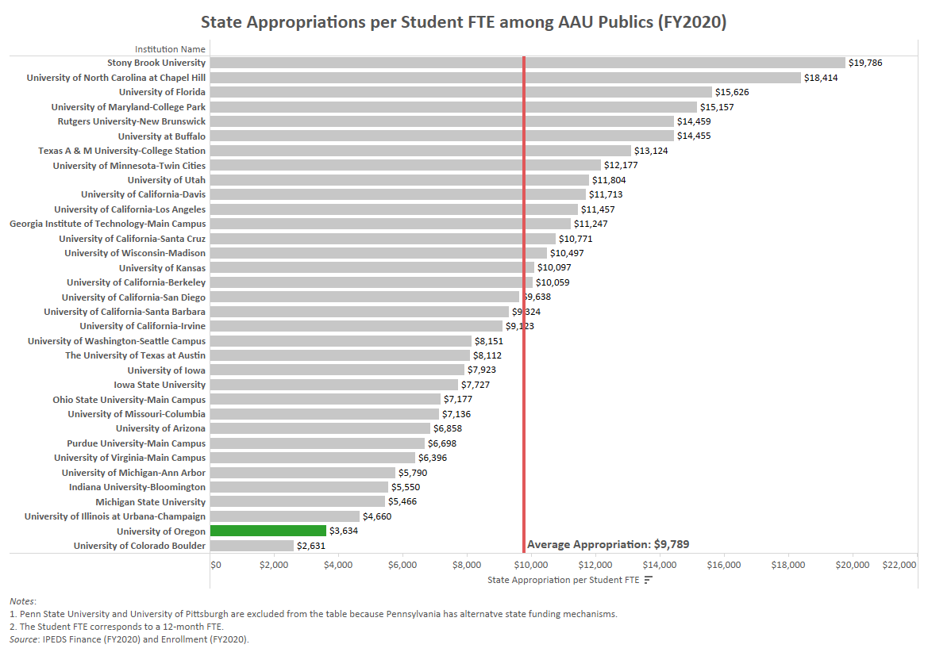

Slide 27
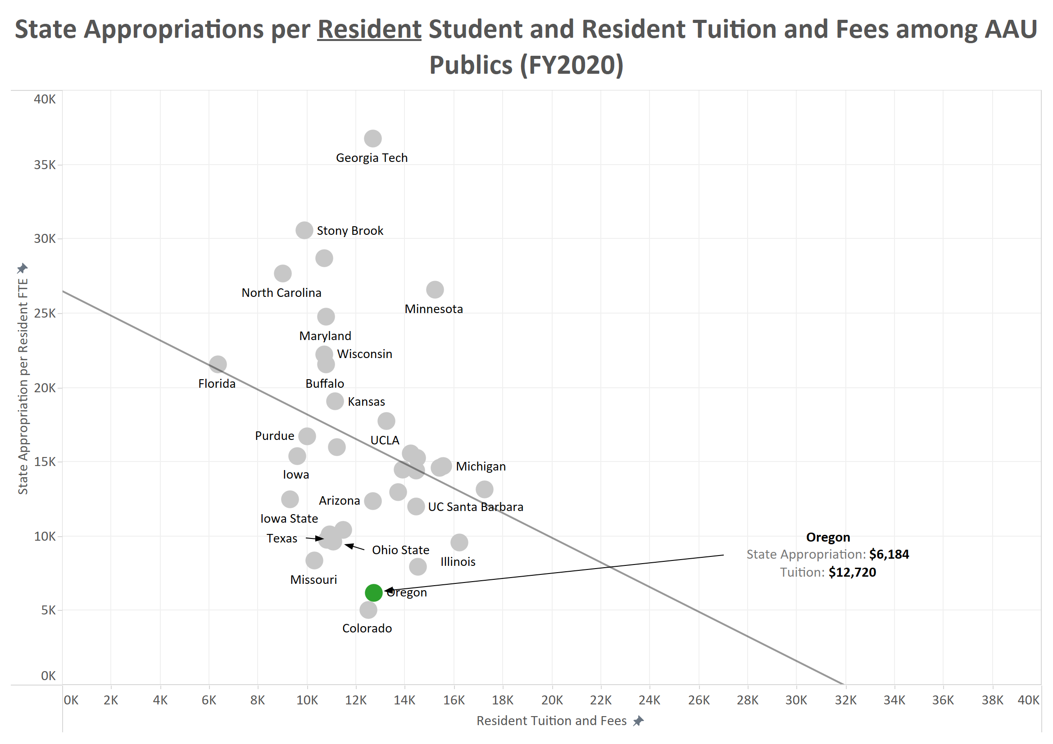

Slide 28
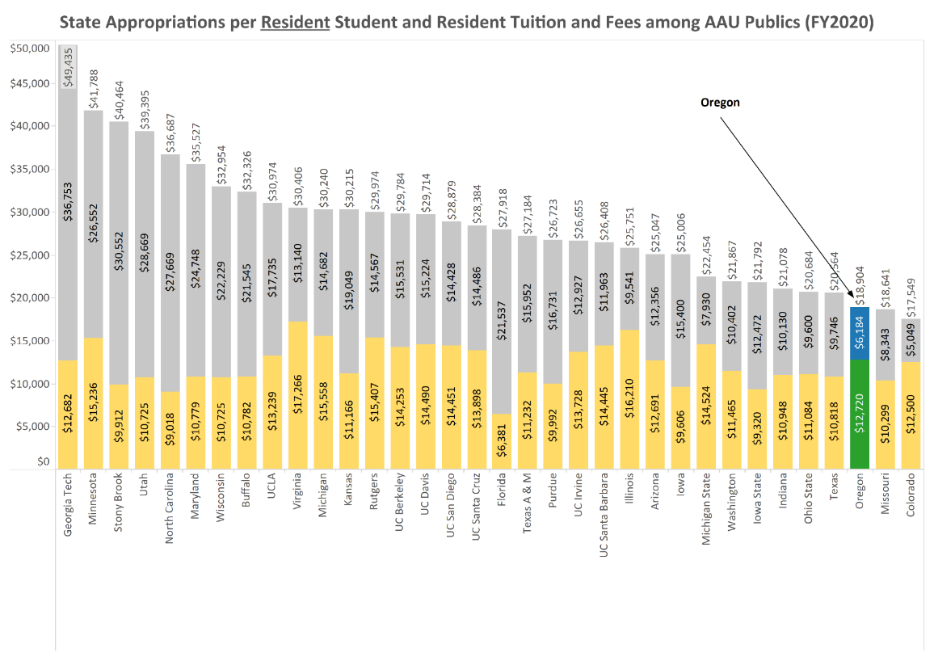

Slide 29
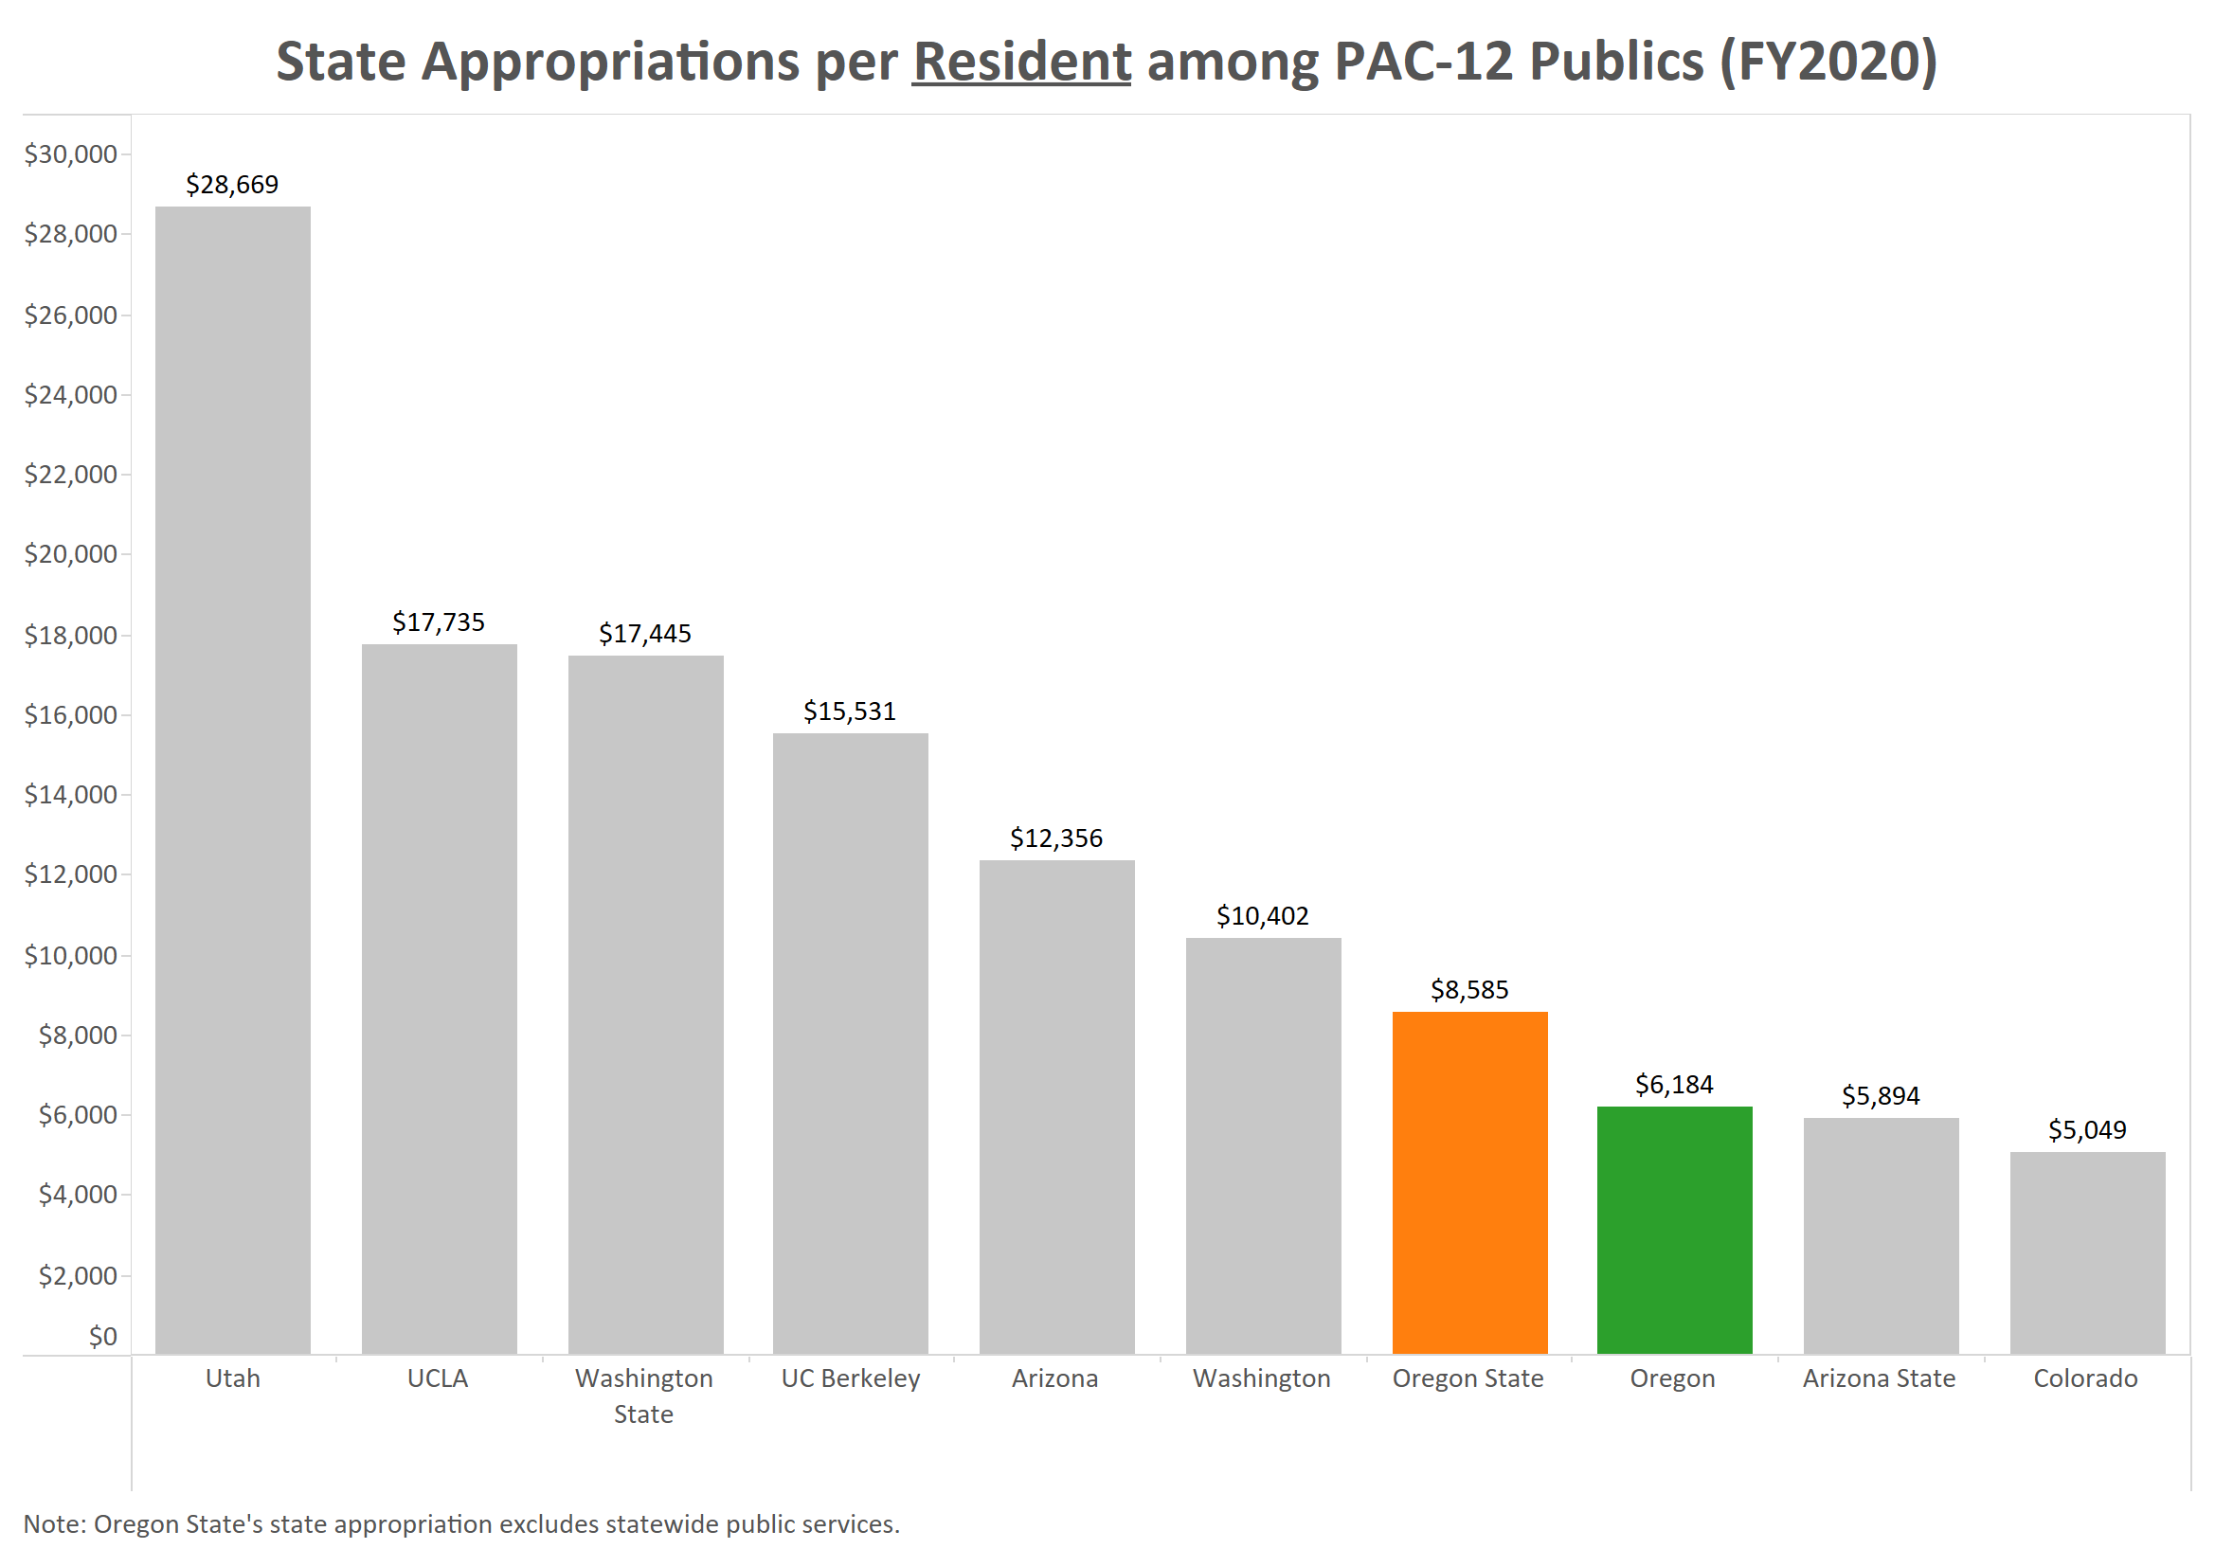

Slide 30
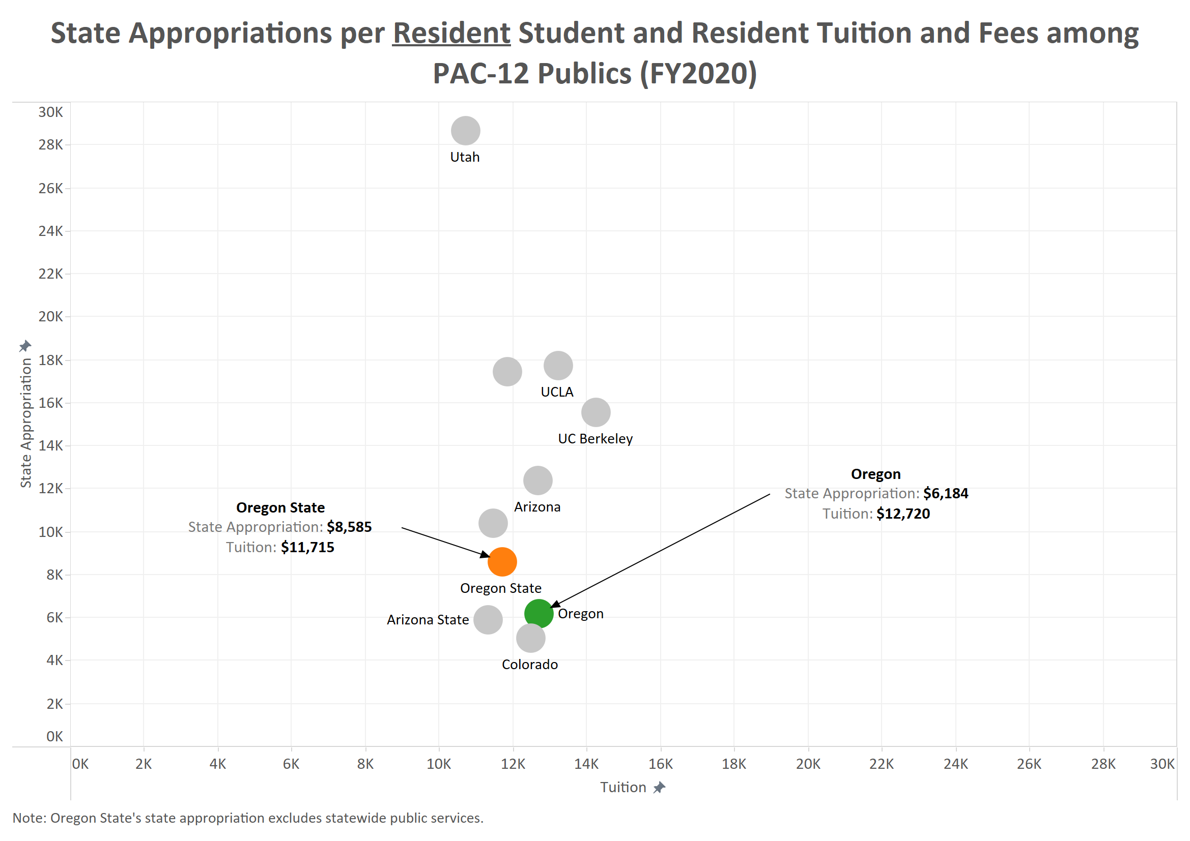

Slide 31
Recent Cost Cutting
FY2017
Administrative Cuts - $3.0M
CAS Cost Cut - $3.3M
FY2018
Presidential Directed Cuts- $4.5M
FY2019:
Administrative and Academic Cuts: $11.6 million
Three year total: $22.4 million per year

Slide 32
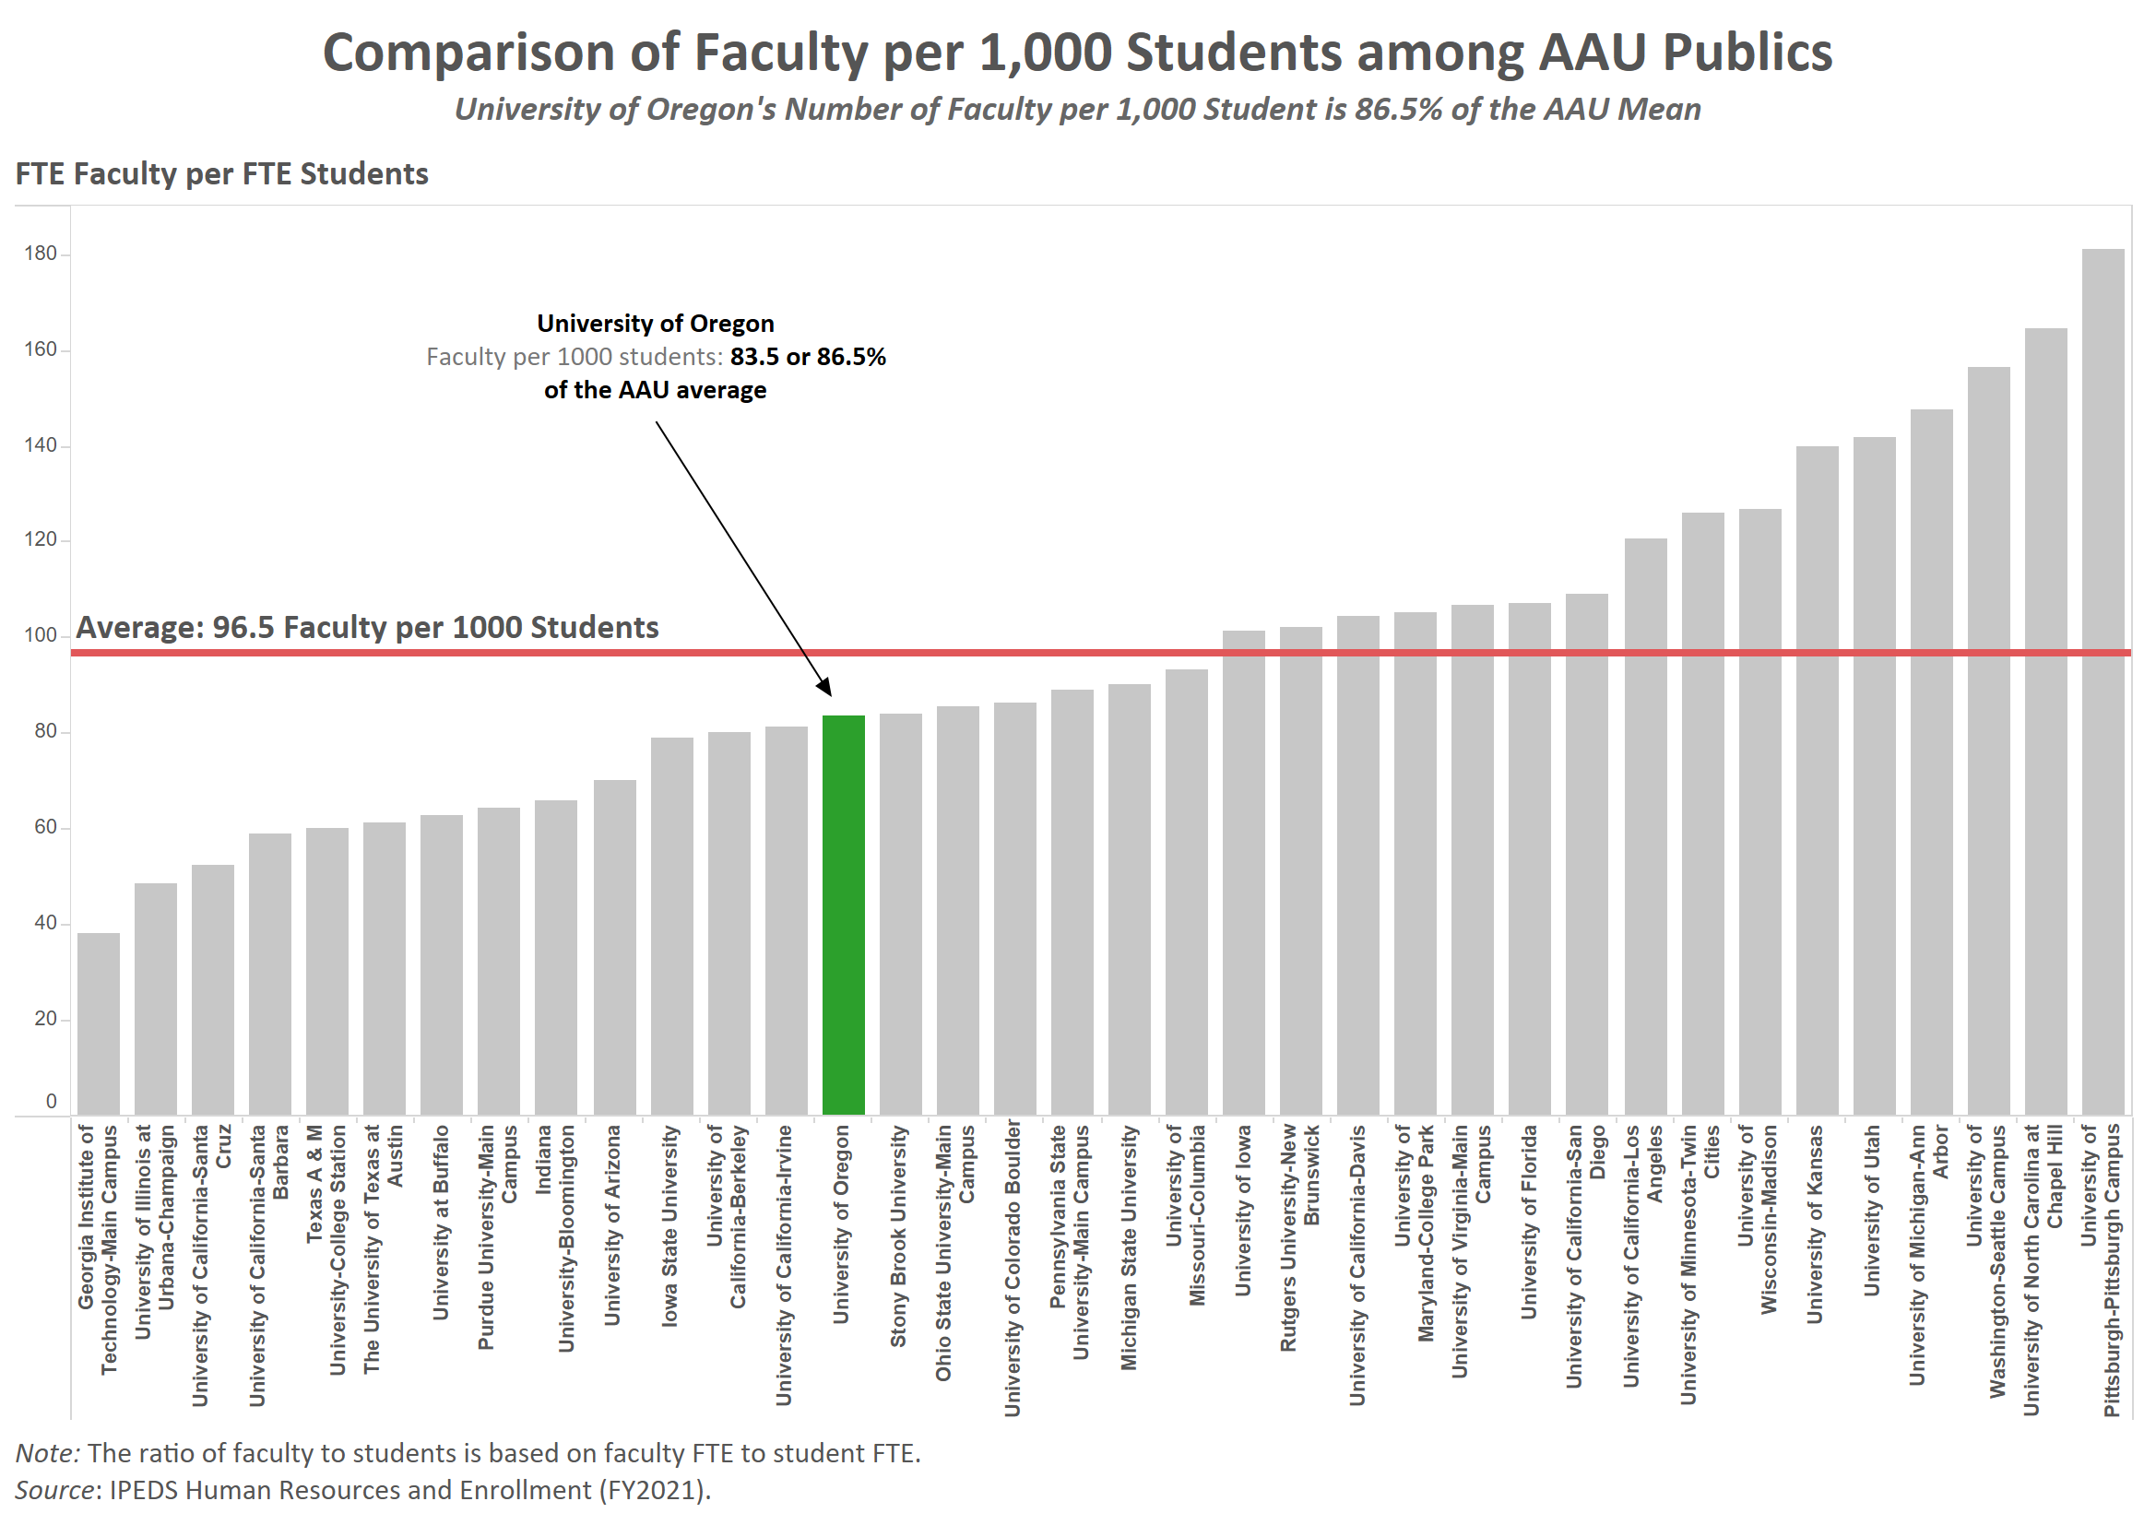
Comparison of Faculty per 1,000 Students among AAU Publics
University of Oregon’s Number of Faculty per 1,000 Students is 86.5% of the AAU Mean

Slide 33
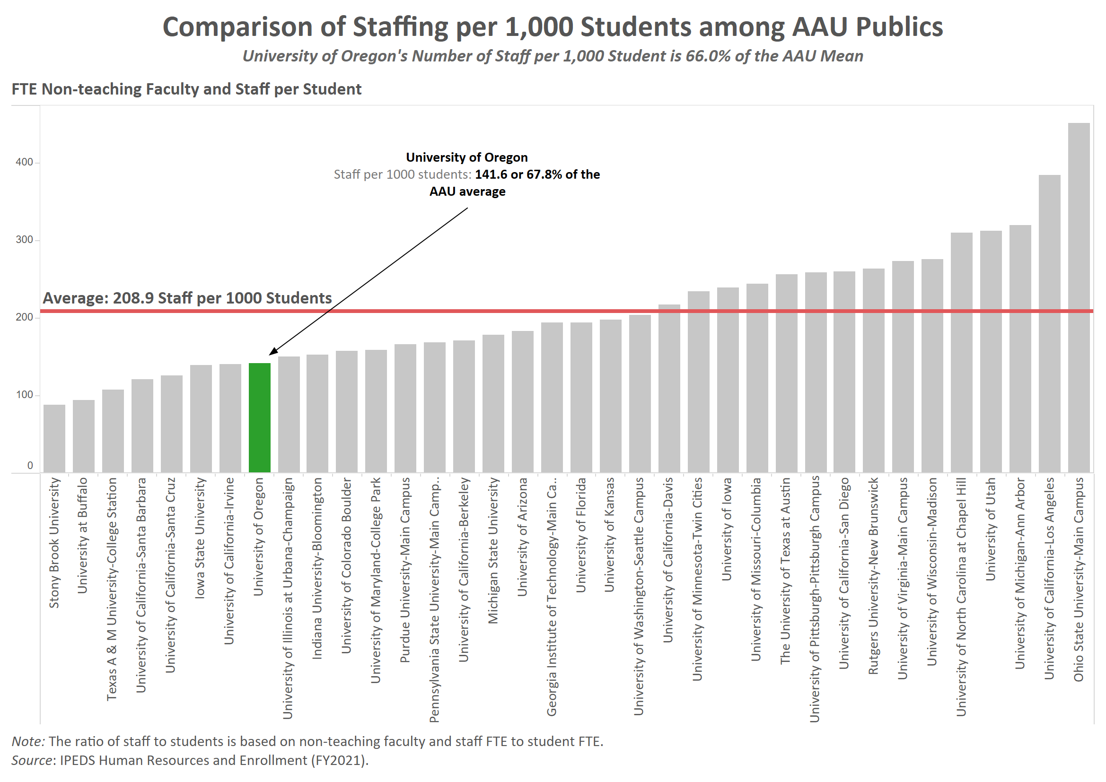
Comparison of Staffing per 1,000 Students among AAU Publics
University of Oregon’s Number of Staff per 1,000 Students is 67.8% of the AAU Mean

Slide 34
Agenda
UO Budget Structure
Key Sources of University Funding
Cost Drivers
E&G Fund Challenges
Impact of COVID-19 on University Finances
Part One
Part Two

Slide 35
COVID Shutdown: March 2020
UO at end of winter term. Institution faced considerable risk related to Spring term.
Enrollments held steady Spring term.
However, significant impact on campus auxiliary operations due to shut down
Housing dropped to under 200 students in dorms
Student Rec Center closed – student fees not charged
EMU almost completely closed – student fees not charged
Child care centers closed
Parking activity down

Slide 36
FY2020: Impact of COVID-19
on Auxiliary Operations
Auxiliary Operation | FY2020 COVID-19 Impact | Notes
Housing and Dining | $11.6 million | Spring term – over 95% drop in number of students living on campus. Full refunds provided for housing and dining fees.
Health Center | $0.7 million
Athletics | No losses spring term | PAC-12 distribution maintained; HR actions, spending freeze, and other expense reductions implemented
EMU | $1.1 million | Spring term student fees refunded as most operations in building closed.
PE & Rec | $2.6 million | Spring term student fees refunded as center was closed
Transportation Services | $577K
Olum Child Care | $253K | Child care services closed Spring term.
Printing and Mailing | $103K
Total Losses | $16.9 million

Slide 37
Actions Taken to Reduce Expenditures
Hiring Freeze
Pay Action Freeze
Travel freeze (for health reasons)
Voluntary pay reductions – senior leadership (President, Provost, Vice Presidents, Deans, Athletic Director)
HR actions in Auxiliary Operations (Leave without Pay with extended benefits; FTE reductions, Layoffs)
Agreement with United Academics to extend collective bargaining agreement (with no annual salary increase) to June 2021
Workshare program – summer FTE reduction program
Direction to limit Services and Supplies (“S&S”) expenditures to essential expenses
Progressive Pay Reduction Plan (“PPR”)

Slide 38
FY2021 E&G Fund Projections
Covid-19 pandemic dramatically affecting FY21 E&G fund finances
Total student enrollment down 3.6% from last year, mainly driven by 12.1% drop in first year undergraduate students
Undergraduate tuition for FY2021 dropped by over $25 million due to COVID
Reduction in number of first year students will affect E&G fund for the next 4-5 years
However, COVID-19 related one time cost savings (e.g., S&S reductions, workshare savings, etc.) are expected to mitigate the revenue losses in the E&G fund for FY2021
FY2021 E&G fund: balanced due to cost savings initiatives

Slide 39
FY2021: Updated Auxiliary Operation Projections
Auxiliary | Initial FY21 Scenarios Size of Loss | Dec Update FY21 Proj Size of Loss | March Update FY21 Proj Size of Loss | May Update FY21 Proj Size of Loss | Notes
Housing and Dining | $11.0 million to $15.1 million | $9.9 million | $9.4 million | $8.2 million | Fall 2020 Housing Residents down approximately 38%. Winter 2021 Housing Residents down approximately 40%. Spring housing residents on track with expectations for the year.
Health Center | $1.0 million to $2.2 million | $0.2 million | $1.5 million | $1.5 million | Additional revenue loss due to increased Covid-19 activities, as well as lower enrollment.
Athletics | $56.3 million to $81.1 million | $63.0 million | $63.0 million | $55.0 million | Additional gift revenue transferred from Foundation; further expense reductions.
EMU | Up to $1.6 million | No loss | No loss | No loss | Expenses reduced to match projected revenue. Incidental fee funding intact.
PE & Rec | Up to $2.1 million | $1.1 million | $1.2 million | $300K | Significant loss of other revenue offset with additional expense reduction actions.

Slide 40
Agenda
UO Budget Structure
Key Sources of University Funding
Cost Drivers
E&G Fund Challenges
Impact of COVID-19 on University Finances
Part One
Part Two

Slide 41
COVID Part Two: FY2022
Enrollment rebounded fall 2021
Federal HEERF funding granted
Unprecedented staffing issues resulted in significant one-time personnel cost savings

Slide 42
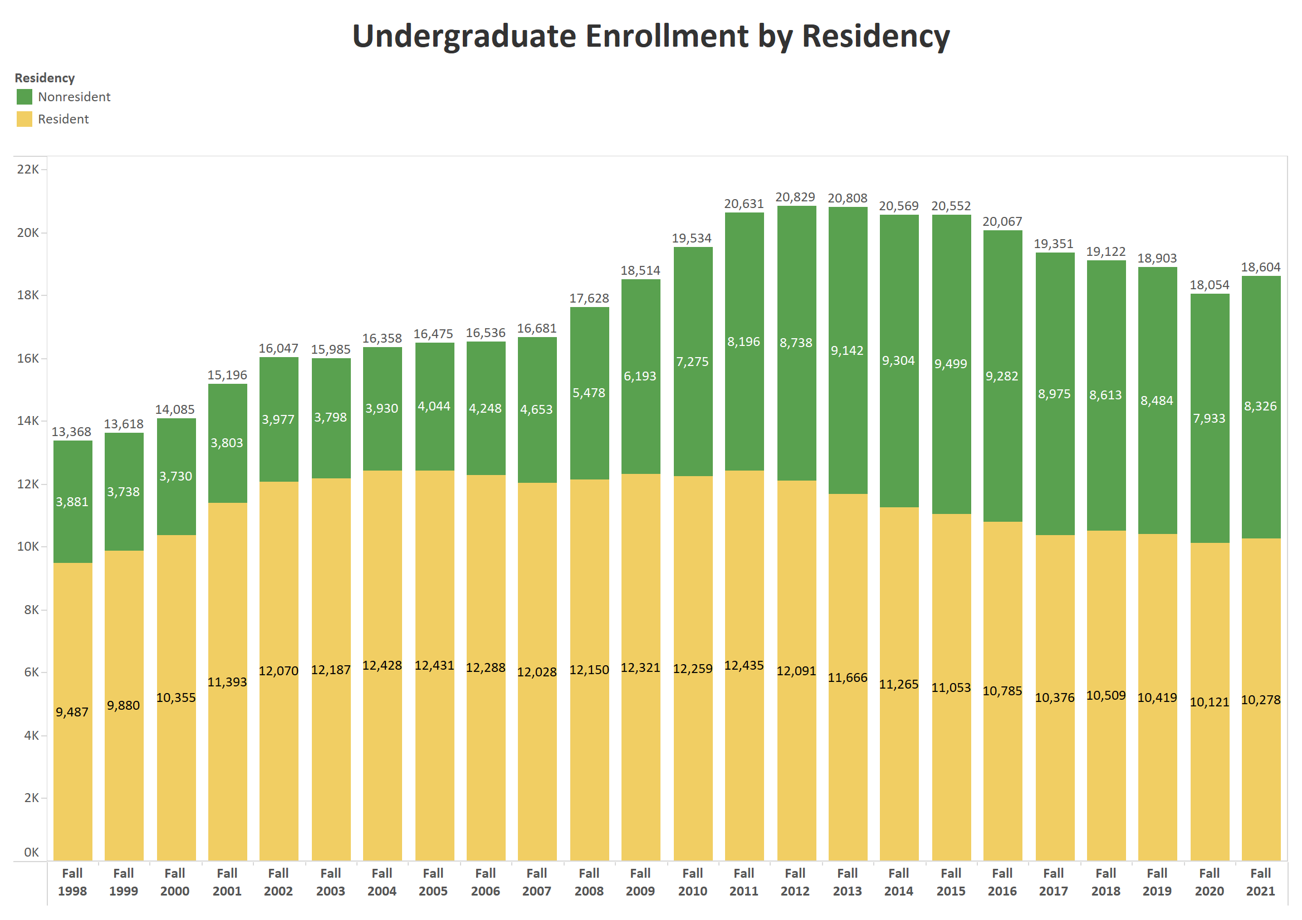

Slide 43
Federal COVID Relief Funds
 | Allocation | Spend (through 08/31/22) | Remaining
Student
HEERF I (CARES) | 8,047,973 | 8,047,973 | -
HEERF II (CRRSAA) | 8,047,973 | 8,047,973 | -
HEERF III (ARP) | 21,425,659 | 21,357,210 | 68,449
Total | 37,521,605 | 37,453,156 | 68,449
Institutional
HEERF I (CARES) | 8,047,973 | 8,047,973 | -
HEERF II (CRRSAA) | 16,102,896 | 15,610,905 | 491,991
HEERF III (ARP) | 21,390,060 | 20,730,168 | 659,892
Total | 45,540,929 | 44,389,046 | 1,151,883
Total
HEERF I (CARES) | 16,095,946 | 16,095,946 | -
HEERF II (CRRSAA) | 24,150,869 | 23,658,878 | 491,991
HEERF III (ARP) | 42,815,719 | 42,087,378 | 728,341
Total | 83,062,534 | 81,842,202 | 1,220,332

Slide 44
Federal COVID Relief Funds
Spend by Project (through 08/31/2022)
Direct Student Support | 37,453,156
Lost Revenue - Tuition | 20,161,330
Reimburse Housing for Student Refunds - Room & Board - Spring, 2020 | 5,500,000
Student Fee Refunds - Online Fee | 4,997,665
Testing/tracing program (including CoronaCorps) | 4,025,868
Direct COVID-19 Expenses - University Health Services | 1,320,543
Direct COVID-19 Expenses - CPFM | 1,231,193
Lost Revenue - University Health Services | 1,179,457
Reimburse PE&Rec for Student Refunds - Rec Center Fees - Spring, 2020 | 1,150,000
Lost Revenue - Parking & Transportation | 1,000,000
Lost Revenue - Research Service Centers | 880,000
Transition in-person classes to remote/online | 735,420
Personal Protective Equipment for students/faculty/staff | 686,727
Replace bathroom fixtures to allow hands-free operation | 536,752
Direct COVID-19 Expenses - Information Services | 329,004
Changes to building air handling equipment - HEPA air filters for classrooms | 170,947
Lost Revenue - Printing | 100,000
Student Vaccination Compliance Program | 76,106
Student Housing Incentives - Self-quarantine | 66,400
Student Vaccination Incentive Awards | 50,000
Installation of Plexiglass panels in common areas | 49,626
Employee Vaccination & Testing Compliance Program | 45,889
Campus signage and decals (i.e., proper spacing in elevators) | 30,943
Sanitizing stations and supplies in common areas and classrooms | 28,623
Large exterior tents to allow for additional physical distancing | 18,387
Other Campus-wide Expenses | 18,164
 | 81,842,202

Slide 45
FY22 Education and General Fund - Year in Review
Revenue
 | FY22 Initial Projection | FY22 Updated Projection Q1 | FY22 Updated Projection Q2 | FY22 Updated Projection Q3 | FY22 Actual Q4 | FY22 Full Year Actual as % of Initial Projection
State Appropriation | $ 86,903,473 | $ 85,750,238 | $ 85,750,238 | $ 85,750,238 | $ 86,620,558 | 99.7%
Tuition and Fees | $ 430,700,000 | $ 436,500,000 | $ 439,500,000 | $ 440,500,000 | $ 444,343,185 | 103.2%
Gifts Grants & Contracts | $ 400,000 | $ 400,000 | $ 400,000 | $ 400,000 | $ 159,843 | 40.0%
ICC Revenue | $ 27,250,000 | $ 28,250,000 | $ 28,250,000 | $ 28,250,000 | $ 28,676,144 | 105.2%
Federal Student Aid | $ - | $ - | $ - | $ - | $ - | -
Interest and Investment | $ 7,971,000 | $ 7,971,000 | $ 8,500,000 | $ 8,800,000 | $ 9,609,350 | 120.6%
Internal Sales | $ 900,000 | $ 900,000 | $ 900,000 | $ 900,000 | $ 908,643 | 101.0%
Sales & Services | $ 4,000,000 | $ 4,000,000 | $ 4,000,000 | $ 4,000,000 | $ 4,436,976 | 110.9%
Other Revenues | $ 2,250,000 | $ 2,250,000 | $ 2,250,000 | $ 2,250,000 | $ 2,473,372 | 109.9%
Transfers From Ore State Agencies | $ - | $ - | $ - | $ - | $ - | -
Total Revenue | $ 560,374,473 | $ 566,021,238 | $ 569,550,238 | $ 570,850,238 | $ 577,228,069 | 103.0%

Slide 46
FY22 Education and General Fund - Year in Review
Expenses
 | FY22 Initial Projection | FY22 Updated Projection Q1 | FY22 Updated Projection Q2 | FY22 Updated Projection Q3 | FY22 Actual Q4 | FY22 Full Year Actual as % of Initial Projection
Total Personnel Services | $ 452,359,000 | $ 452,359,000 | $ 443,400,000 | $ 438,000,000 | $ 434,891,343 | 96.1%
Service & Supplies | $ 109,100,000 | $ 112,600,000 | $ 112,600,000 | $ 112,600,000 | $ 109,884,107 | 100.7%
Merchandise-Resale/Redistribution | $ 5,100 | $ 5,100 | $ 5,100 | $ 5,100 | $ 9,869 | 193.5%
Internal Sales Reimbursements | $ (16,100,000) | $ (16,100,000) | $ (16,100,000) | $ (16,100,000) | $ (16,518,752) | 102.6%
Indirect Costs | $ 34,000 | $ 34,000 | $ 34,000 | $ 34,000 | $ 4,677 | 13.8%
Depreciation/Amortization Expense | $ - | $ - | $ - | $ - | $ - | -
Student Aid | $ 6,765,000 | $ 6,765,000 | $ 5,000,000 | $ 4,000,000 | $ 3,826,346 | 56.6%
Total General Expense | $ 99,804,100 | $ 103,304,100 | $ 101,539,100 | $ 100,539,100 | $ 97,206,247 | 97.4%
 |  |  |  |  | -
Net Transfers Out(In)* | $ 6,900,000 | $ 8,900,000 | $ 8,900,000 | $ 25,900,000 | $ 27,254,440 | 395.0%
 |  |  |  |  |  | -
Total Expense | $ 559,063,100 | $ 564,563,100 | $ 553,839,100 | $ 564,439,100 | $ 559,352,030 | 100.1%
Net before CapEx | $ 1,311,373 | $ 1,458,138 | $ 15,711,138 | $ 6,411,138 | $ 17,876,039 | 1363.2%
 |  |  |  |  | -
Beginning Fund Balance | $ 61,285,476 | $ 61,285,476 | $ 61,285,476 | $ 61,285,476 | $ 61,285,476 | 100.0%
Capital Expenditures** | $ (5,100,000) | $ (5,100,000) | $ (5,100,000) | $ (4,000,000) | $ (5,101,140) | 100.0%
Net (from above) | $ 1,311,373 | $ 1,458,138 | $ 15,711,138 | $ 6,411,138 | $ 17,876,039 | 1363.2%
Fund Additions/Deductions | $ - | $ - | $ - | $ - | $ 548,976 | -
Federal COVID-19 Relief Funds | $ 18,700,000 | $ 18,700,000 | $ 18,700,000 | $ 18,700,000 | $ 18,700,000 | 100.0%
Ending Fund Balance*** | $ 76,196,849 | $ 76,343,614 | $ 90,596,614 | $ 82,396,614 | $ 93,309,351 | 122.5%
* - Net Transfers include transfers to Plant funds for capital construction projects and transfers to other funds for support
** - Capital Expenditures includes IS/Research computer servers and networks, library collections, vehicles and general equipment

Slide 47
E&G Fund Balance
 | FY2018 | FY2019 | FY2020 | FY2021 | FY2022
Total Expenses including CapEx | $520M | $544M | $552.6M | $524.1M | 564.5M
Weekly OpEx | $10.0M | 10.5M | $10.6M | $10.1M | $10.9M
End of Year Fund Balance | $80.0M | $65.4M | $56.7M | $65.3M | $93.3M
Weeks of OpEx | 8.0 | 6.3 | 5.3 | 6.5 | 8.6

Slide 48
First Year Students – Fall Term

Slide 49
FY2023 & Beyond
Tuition revenue strong
Staffing level still abnormally low
Risks / Issues
Funding needed to add back faculty and staff
Impact of inflation on cost base
Potential for recession and cut to state funding
Ability to continue strong enrollment growth in face of demographic challenges

